Slide 1
Professions (2)
العَمَل (2)
Dr. Ehab Atta

Slide 2
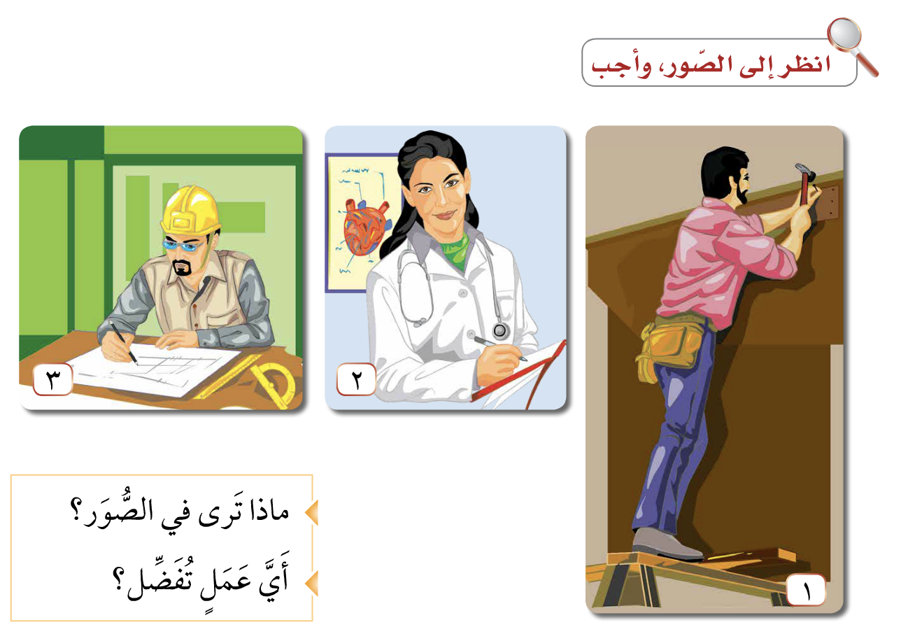

Slide 3
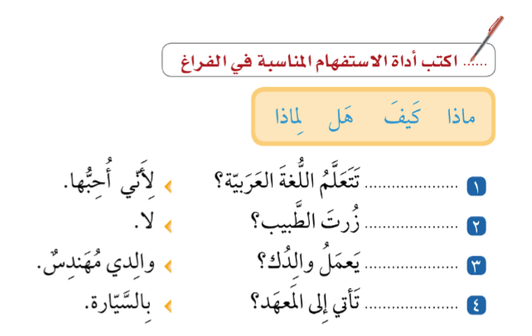

Slide 4


Slide 5
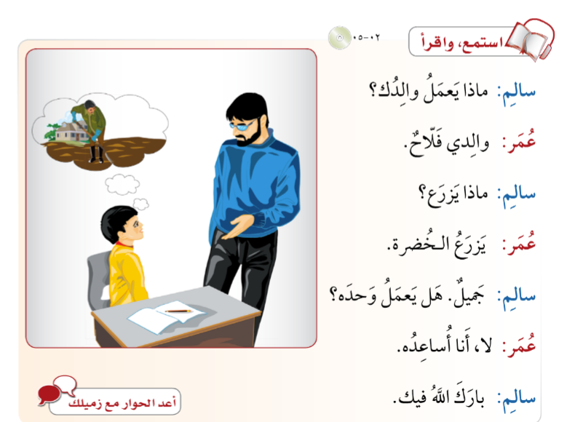

Slide 6


Slide 7
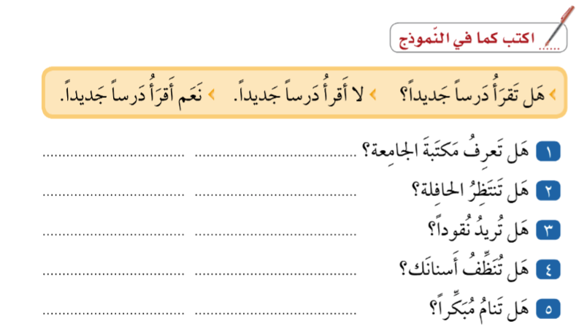

Slide 8
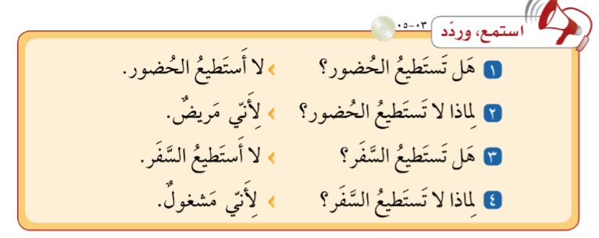

Slide 9


