Slide 1
المَدْرَسَةُ العائِمَةُ في بَنْغلادِش
Dr. Ehab Atta

Slide 2
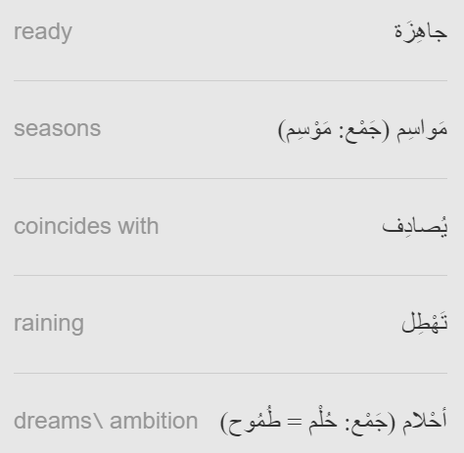
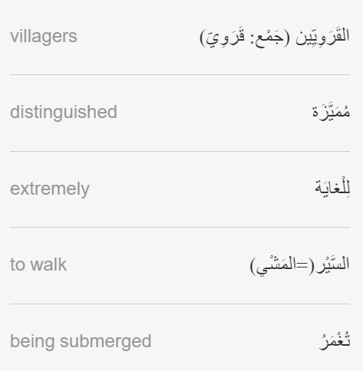

Slide 3
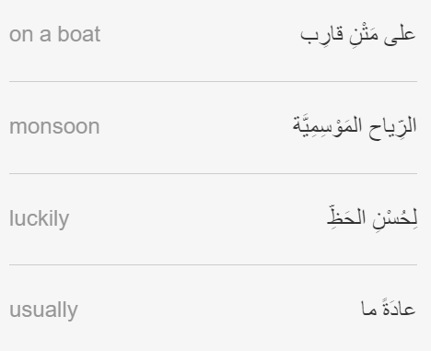
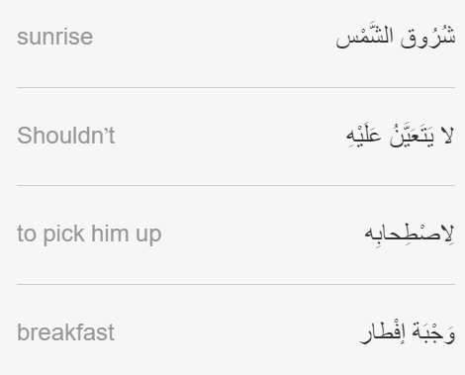

Slide 4
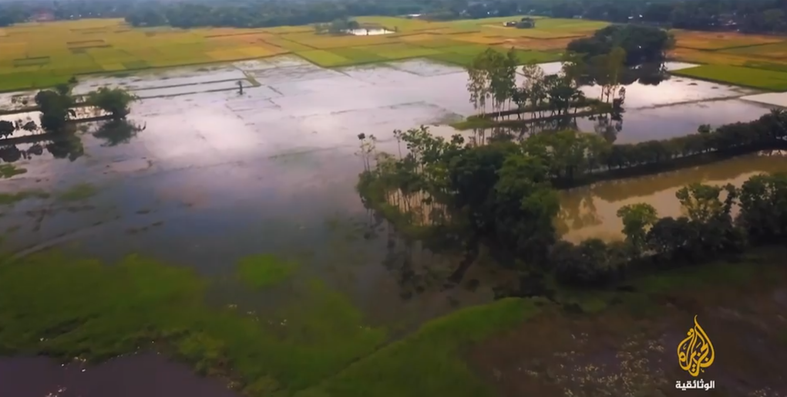
https://learning.aljazeera.net/ar/articles/pages/21919

Slide 5
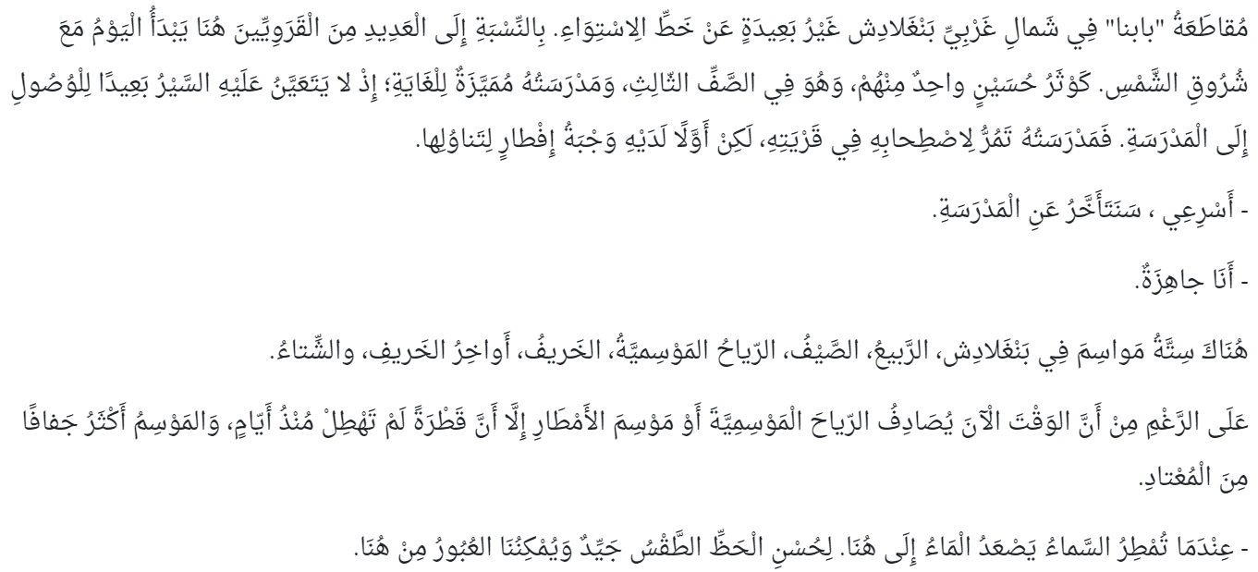

Slide 6
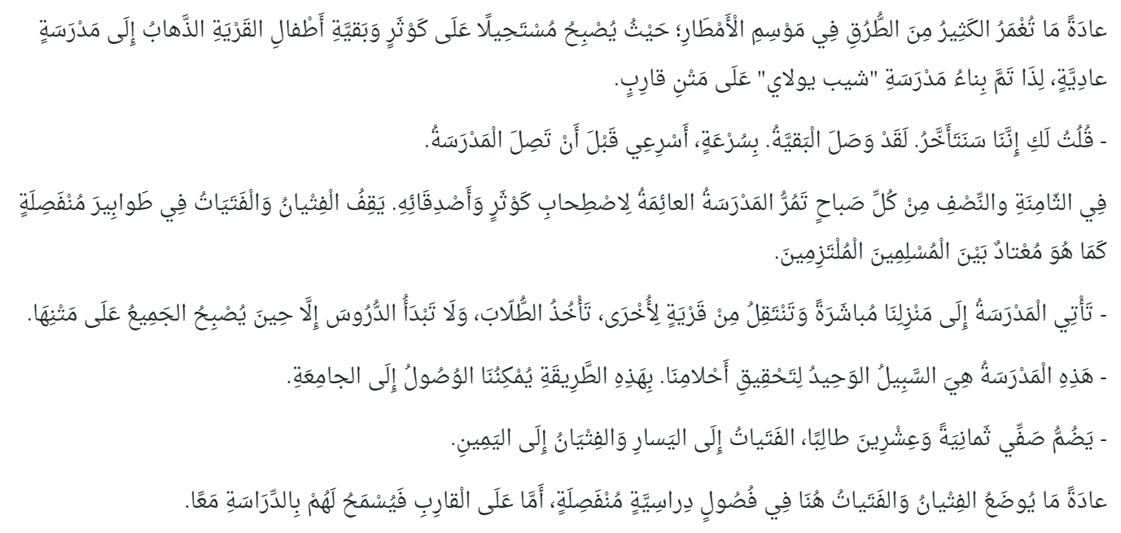

Slide 7


