Slide 1
Travel (2)
السَّفَر (2)
Dr. Ehab Atta

Slide 2
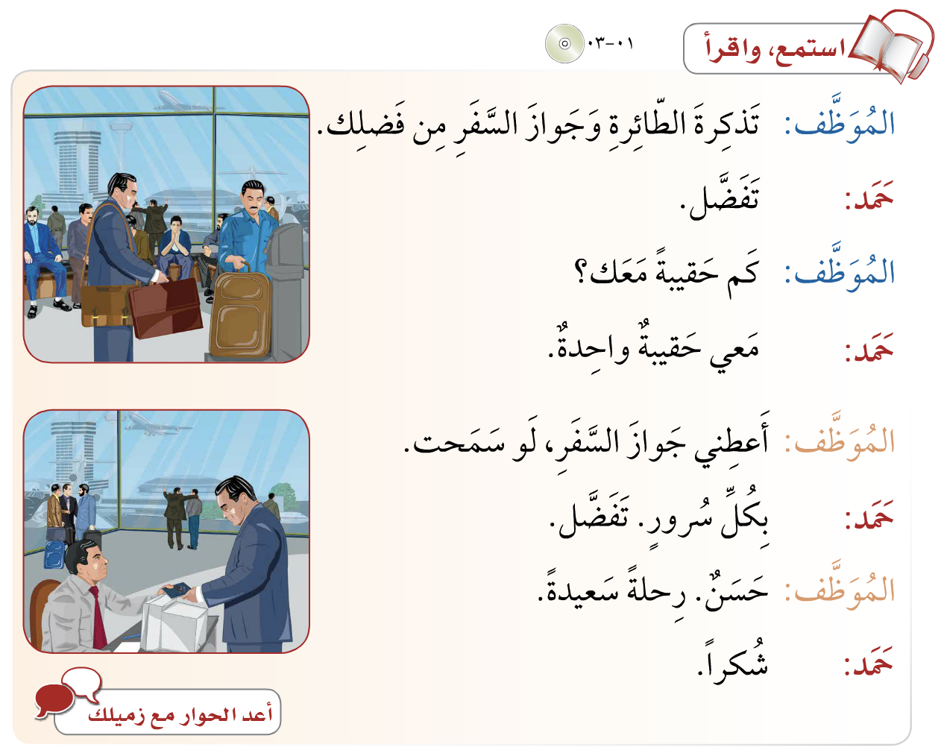

Slide 3
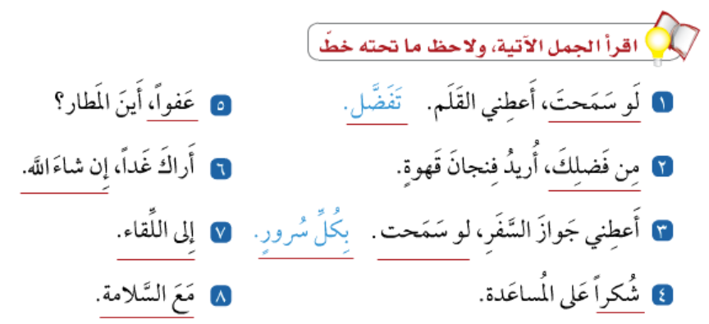

Slide 4
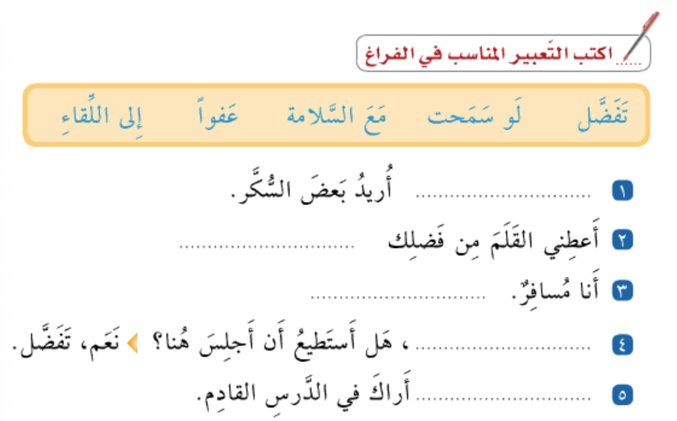

Slide 5
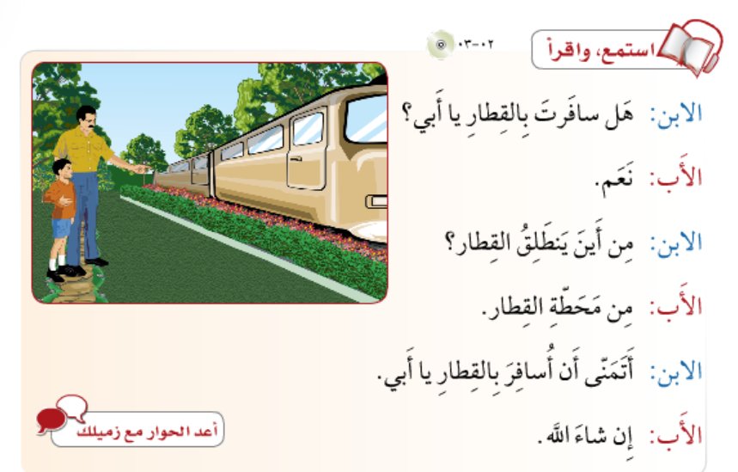

Slide 6
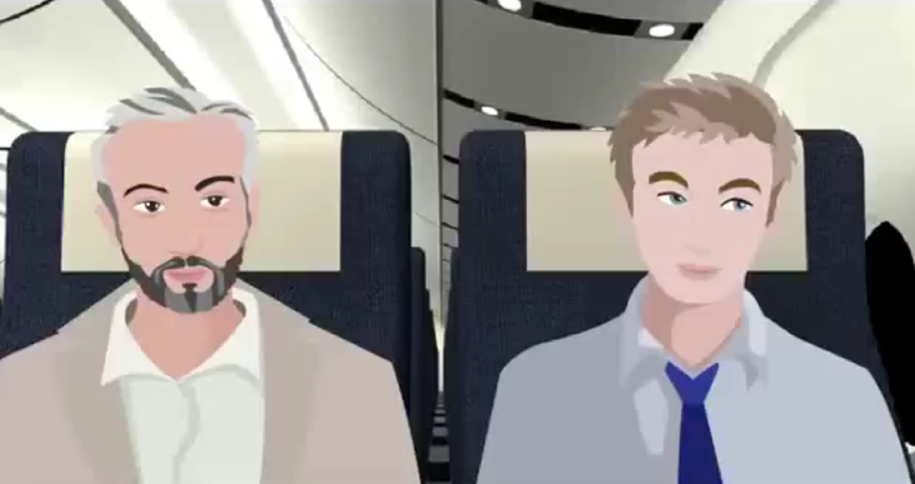
https://www.youtube.com/watch?v=NertP2HlMxU&list=PLRtmzTw9YzYkPHA3Wg65-arwRU_eiA1rE

Slide 7


