Slide 1
السِّياحَةُ بِالْـمَنازِلِ المُتَحَرِّكَةِ
Dr. Ehab Atta

Slide 2
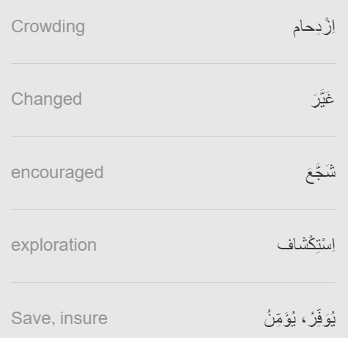
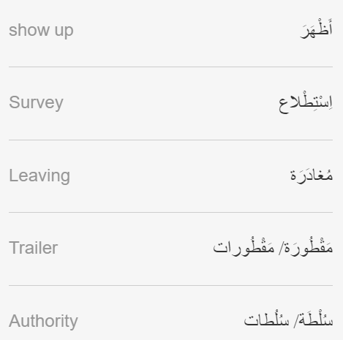

Slide 3
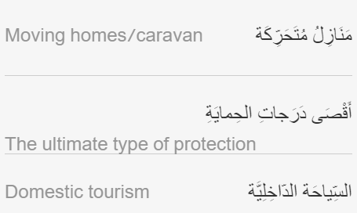
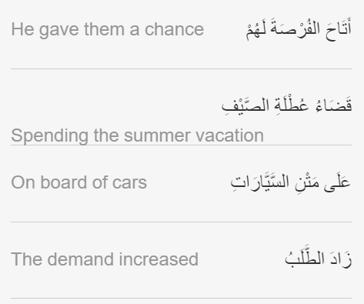

Slide 4
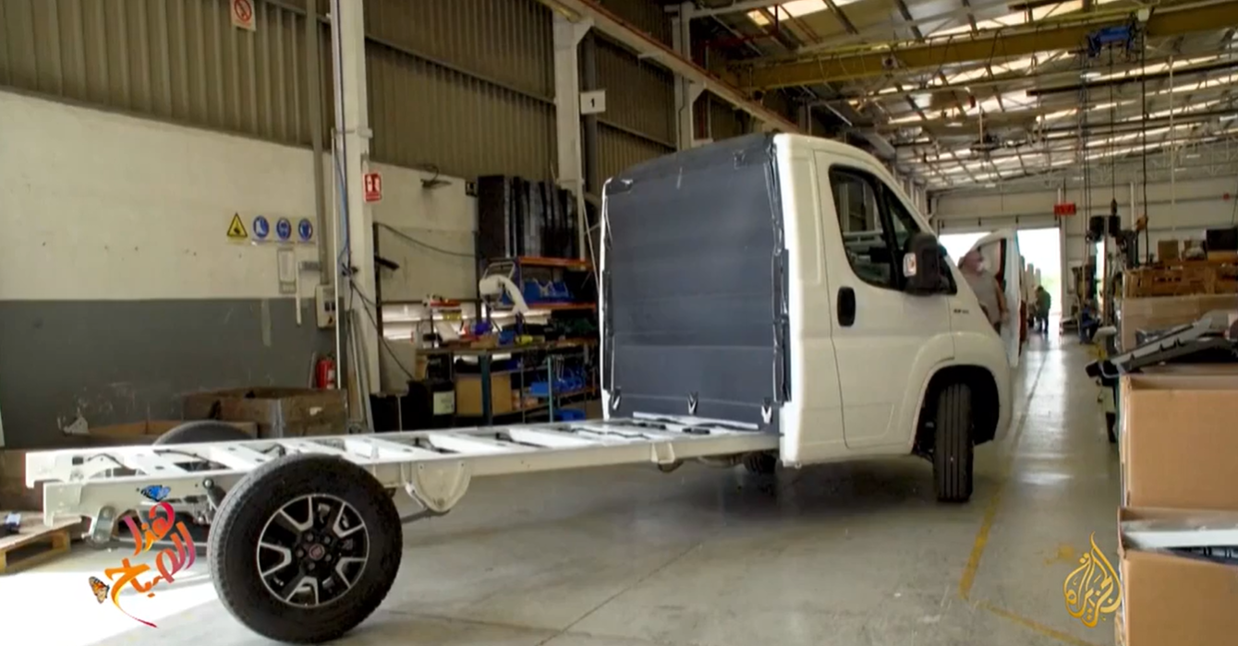
https://learning.aljazeera.net/ar/node/20758

Slide 5
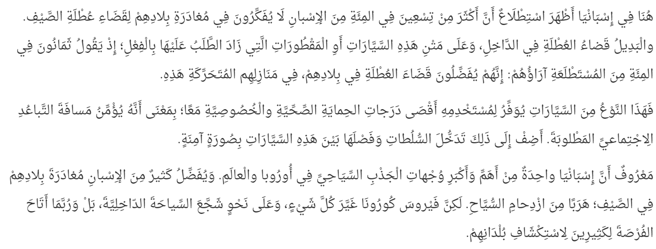

Slide 6


