Slide 1
Sira Rassul Allah
PBUH
SER 151 – History & Seerah Curriculum – Lecture No. 1
Dr. Nemat Awadalla

Slide 2
Introduction
I testify that there is no GOD but ALLAH and Muhammad is his slave and messenger
أشهد أن لا إله إلا الله وأن محمدًاعبده ورسوله

Slide 3
Introduction
Every Muslim must be taught the life of the Messenger of Allah (PBUH). But not in the sense of general information

Slide 4
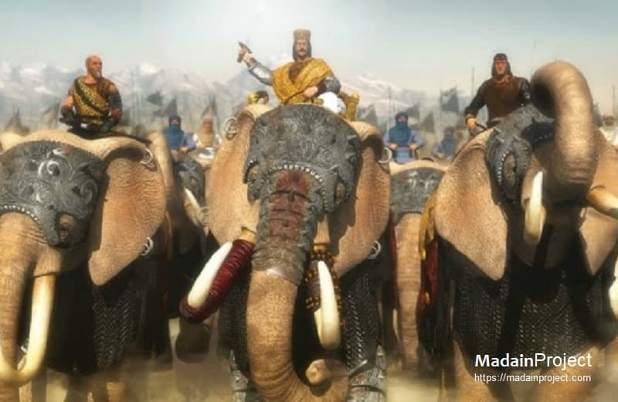
Introduction

Slide 5
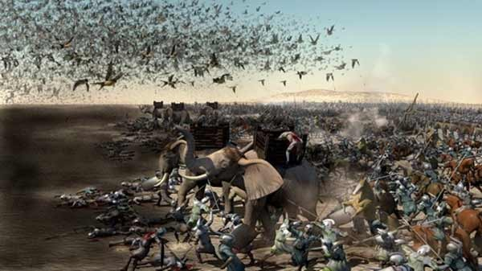
Introduction

Slide 6
The Birth
Amena used to say:
“I'm fine ... I'm not complaining of what pregnant women complain of.
I feel light and energetic that I can help myself. I thank you all
At an illuminated night, Amena felt that this was the day of her child’s birth, whom she had been waiting for eagerly. It was Monday’s night, 12 Rabi’ the First.

Slide 7
SIRA
O you that believe! Send your blessings on him, and salute him with all respect.”
يا ايها الذين امنوا صلوا عليه وسلموا تسليما

Slide 8
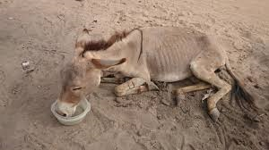
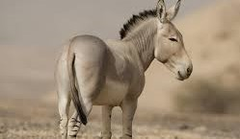
SIRA

Slide 9
SIRA
ولد الهدى فالكائنات ضياء ♦♦ وفم الزمان تبسم وثناء
Al-Huda was born, the beings are shining
and the universe is smiling and praising

