Slide 1
جَوْلَةٌ في مَلاعِبِ كَأْسِ العالَمِ بِدَوْلَةِ قَطَر
Dr. Ehab Atta

Slide 2
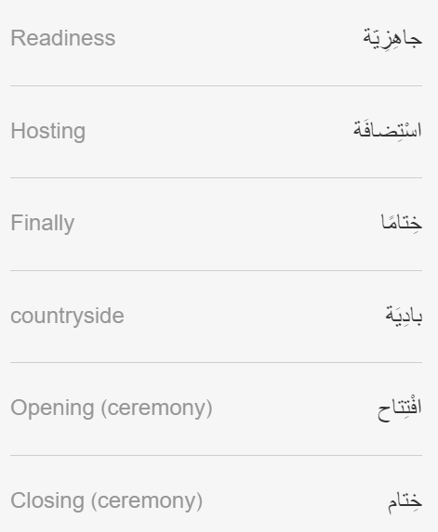
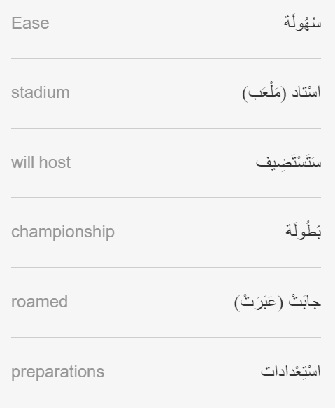

Slide 3
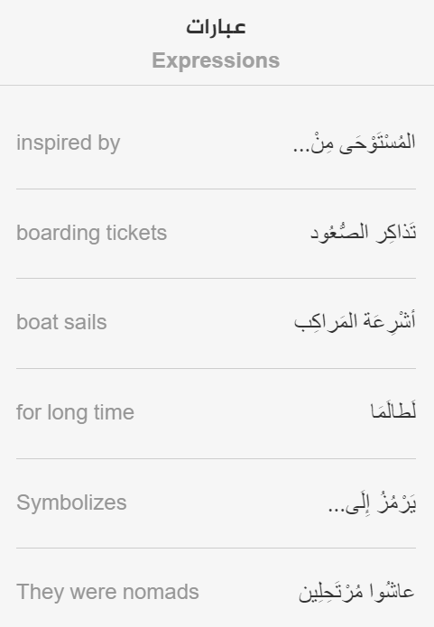

Slide 4
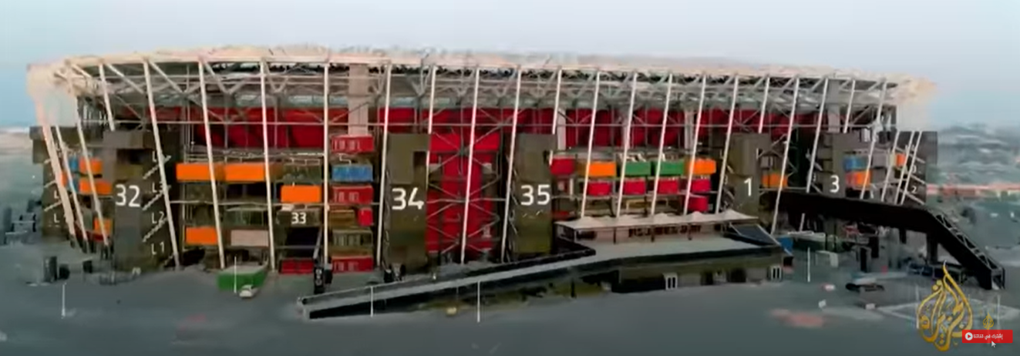
https://learning.aljazeera.net/ar/articles/pages/21995

