Slide 1
أُسْرَتِي
Dr. Ehab Atta

Slide 2
https://learning.aljazeera.net/ar/node/19294

Slide 4
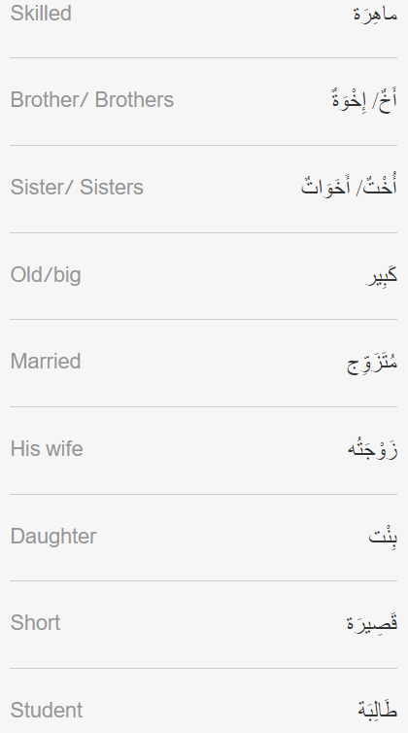
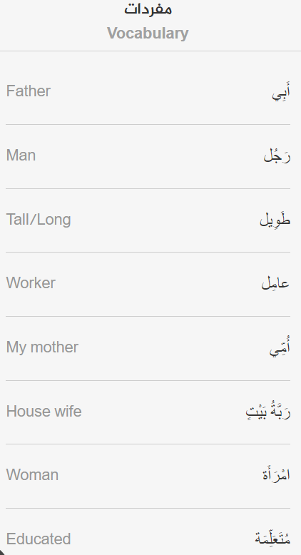

Slide 5
