Slide 1
TAFSEER
QRN 111 – Tafsir Curriculum – Lecture No. 1
Imam Adnan Balihodzic
First Semester
1442H/2020

Slide 2
Agenda
Lecture No. 1
Introduction to the subject of Tafseer
Tafseer of Surah al-Fatihah
Tafseer of Surah al-Naba’

Slide 3
Introduction to the subject of Tafseer
Tafseer (Tafsīr, Arabic: “explanation,” “exegesis”) - The science by which the Qur’an is understood, its meanings explained, and its rulings derived. (The science of explanation of the Qurʾān, or of Qurʾānic commentary)
Qur’an - The words of Allah revealed to Muḥammad (saws), the recitation of which is a form of worship (‘ibadah). It is a definition that cannot be applied to any other book or speech.
Importance and Methodology of Tafseer
Many portions of the Quran are pretty clear and self-explanatory and need not to be explained, but other parts may lead to some major confusion if the person does not know, who/what the verse is referring to, what the story/topic is, in what time period did this take place? This is called Asbaabun-Nuzul (Reasons for Revelation). To know all of this, implies that one must seek knowledge of the Quran from the proper sources of tafseer.

Slide 4
Introduction to the subject of Tafseer
Sahabah’s methodology
The Sahabah’s methodology was of three "major" categories and this was passed on to the next generations. They would understand the Quran: 1) In light of other verses of the Quran, ie. Qur’an by Qur’an. 2) In light of the Prophetic traditions (Hadeeth) that they had preserved with them, ie. Qur’an by Sunnah/Hadeeth. 3) In light of the Arabic language.
They feared saying anything about the Quran with opinion because they knew what a big sin it would be upon them. As Abu Bakr (ra) used to say, when asked a question about a verse from the Quran, "What earth would carry me and what sky would shade me if I should speak about the Quran with my opinion or by something I do not know". And Umar (ra) was known to say, "Beware of using your opinions in religious matters".
Amongst most knowledgeable Sahabahs: Ibn Abbas (Tarjumanul-Qur’an/Interpreter of the Qur’an), Ibn Mas’ud, Abu Bakr, Umar, Uthman, Ali ibn Abu Talib, Ubay ibn Kaab, Zayd ibn Thabit, Abu Musa al-Ash’ari, Abdullah ibn Zubayr and many more. There are many authentic hadeeth, where the Prophet (SAW) explained the knowledge and characters of these men and he ordered us to follow them after him.

Slide 5
Introduction to the subject of Tafseer
Classical works of Tafseer
Others, from early time, explained Qurʾānic passages using stories from the People of the Book (Ahlul-Kitab) which were backed up in the Quran and Sunnah, drawn from Christian—and especially from Jewish—sources (Isrāʾīliyyāt). Some would sometimes use personal ijtihad (personal speculation, known as tafsīr bil-raʾy), although this was very limited.
To counter such interpretations, in the fourth Islamic century (10th century CE) there emerged the religious science called ʿilm al-tafsīr, a systematic exegesis of the Qurʾānic text, which proceeds verse by verse, or even word by word. Over time this science developed several methods and forms of its own.
The monumental commentary compiled by the historian al-Ṭabarī (838/839–923) assembled all the traditional scholarship that had been produced until his time. It remains the most basic of all tafsīrs. Subsequent commentaries of note include those by al-Zamakhsharī (1075–1143), al-Rāzī (1149–1209), al-Bayḍāwī (d. 1280), and al-Suyūṭī (1445–1505). Also, al-Qurtubi (1214-1273), and, one of the most famous book of tafsir, that of Ibn Kathir (1300-1373). Commentaries continue to be compiled at the present time.

Slide 6
Tafseer of SŪRAH AL-FĀTIḤAH
It was the described by the Messenger of Allah as the greatest sūrah in the Qur’ān (no. 1st in it).
Was revealed during the Makkan period and was the first sūrah to be sent down to the Prophet (PBUH) in its entirety. Parts of some other sūrahs had been revealed prior to it, the earliest of them being the first five verses of Sūrah al-‘Alaq.
Names of Surah Fatihah
Name (transliteration) | Name (translation)
As-Sab‘ul-Mathānī wal-Qur’ān al-‘Atheem | The Seven Oft-Repeated Verses and the Great Recitation
Fātiḥat al-Kitāb | The Opening of the Book
Umm al-Qur’ān | The Mother of the Qur’ān
Sūrat-ul-Ḥamd | The Sūrah of Praise

Slide 7
The OPENING سورة الفاتحة
1. In the name of Allah, the Compassionate, the Merciful. | ﴿١﴾ بِسْمِ اللَّهِ الرَّحْمَٰنِ الرَّحِيمِ
2. Praise be to Allah, Lord of the Worlds. | ﴿٢﴾ الْحَمْدُ لِلَّهِ رَبِّ الْعَالَمِينَ
3. The Compassionate, the Merciful. | ﴿٣﴾ الرَّحْمَٰنِ الرَّحِيمِ
4. Master of the Day of Judgment. | ﴿٤﴾ مَالِكِ يَوْمِ الدِّينِ
5. You alone we worship; and upon You, we call for help. | ﴿٥﴾ إِيَّاكَ نَعْبُدُ وَإِيَّاكَ نَسْتَعِينُ
6. Guide us along the straight path. | ﴿٦﴾ اهْدِنَا الصِّرَاطَ الْمُسْتَقِيمَ
7. The path of those You have blessed, not of those with anger on them, nor of the misguided. | ﴿٧﴾ صِرَاطَ الَّذِينَ أَنْعَمْتَ عَلَيْهِمْ غَيْرِ الْمَغْضُوبِ عَلَيْهِمْ وَلَا الضَّالِّينَ

Slide 8
Tafseer of SŪRAH AL-FĀTIḤAH
The meaning of Bismillāh is: "[I begin] in the name of Allah." Bism literally means "by the name of" or "with the name of" and is a contraction of two words: bi (by/with) and ism (name).
Scholars have differed over whether the basmalah (the words "BismillāhirRaḥmānirRaḥeem") is part of the sūrah or merely an indication of its beginning. In most copies of the Arabic mus·ḥaf today it appears as a distinct āyah (verse) in Sūrah al-Fātiḥah but not in other sūrahs.
"All Praises and thanks are due to Allah, the Lord of the Universe“ - Allāh الله is the proper name of the one eternal, unique, absolute and perfect deity who is the Creator and Sustainer of all that exists. It is a word that indicates the Only Being that possesses the qualities of divinity and lordship. The definite article, al (has merged into the word ilāh – an object of worship). This definite article is an integral part of the word’s structure and cannot be separated from it – thus establishing the meaning of the true object of worship and the only deity worthy of worship.
Therefore, this name is applicable to the One and Only true God, and nothing else can be called "Allāh". Moreover, it is inclusive of all of His descriptive names and attributes; so many scholars have expressed the opinion that it is the greatest of His names. Unlike His creations, Allah is timeless and eternal, without beginning or end. He is the one and only Lord of the entire universe. He is the Creator and Sustainer upon which all creation depends for its existence at every moment.

Slide 9
Tafseer of SŪRAH AL-FĀTIḤAH
Ar-Raḥmān - merciful in the absolute sense; thus, it is used to describe Allah alone, while raḥeem might be used to describe a human being as well. Raḥmān emphasizes the concept of being entirely, intensely and absolutely merciful with mercy that encompasses all of creation. One component of this mercy is justice, which will be fully manifested in the Hereafter.
Ar-Raḥeem - includes the concepts of continuity and specialization; i.e., He is especially and specifically merciful to the believers, given that they are more deserving of His mercy than others.
"Ar-Raḥmān ar-Raḥeem" is repeated again in the verse after the mention of divine lordship (Lord of the worlds, to whom humble servitude is due) to emphasize His mercy.
“Master of the Day of Judgment” Allah not only affirms that He is Lord of the presently existing worlds, but that He is also the Owner and Inheritor of the Day of Recompense, for which He will have created new worlds. Mālik and Malik are both established ways of reciting the first word of this āyah. Each has been reported with continuous transmission going back to the Prophet (PBUH).

Slide 10
Tafseer of SŪRAH AL-FĀTIḤAH
“You alone we worship; and You Alone we ask for help"” - Thus far, Allah, the Exalted, has referred to Himself in the third person. At this point He instructs His servants to address Him directly in the second person, evoking consciousness of His presence. The āyah conveys the essential principle of tawḥeed, which is the logical result of the sūrah's preceding descriptions. It defined the method of obtaining Allah's acceptance and approval, namely by worshipping Him alone and by seeking His help to worship Him in a proper way.
“We” - many actions of worship in congregation and recommended to supplicate for other Muslims.
"Guide us to the Straight Path” - After praising Allah, the servant then proceeds to ask of Him from His bounty and blessings. This is the most virtuous way of asking Allah by first praising Him and then asking of Him. The Straight Path is the path that the one journeying to Allah traverses and it is none other than obedience to Allah and His Messenger (sallallahu 'alayhi wa sallam), ie. Islam.
After the servant has requested for guidance to the Straight Path, Allah then proceeds to clarify further what this Straight Path is - "The Path of those whom You have favoured/blessed, Not the path of those who have earned [Your] anger, nor those misguided/who have gone astray.”
It is recommended for the one who is reciting the Qur'an to say amin after having recited Al-Fatihah.

Slide 11
Meaning of Worship/’Ibadah
According to Surah Fatihah
Praising Him
Acknowled-ging His sovereignty
Seeking Guidance from Him
Making Duaa to Him

Slide 12
Tafseer of Surah al-Naba’
Name-The Surah (no.78th in the Qur’an) derived its name from the word an-Naba (the Great News) in the second verse. This is not only a name but also a title of its subject matter, for Naba implies the news of Resurrection and Hereafter.
Period of Revelation-The theme of all the Surahs, from Al-Qiyamah (75th) to An-Naziat (79th), closely resembles one another's, and all these have been revealed in the earliest period at Makkah. Its theme also is to affirm the Resurrection and Hereafter, and to warn the people of the consequences of acknowledging or disacknowledging it.
The Surah opens by shunning the enquirers and the inquiry. It wonders that anyone should raise doubts about Resurrection and Judgment, which were central points of bitter controversy. For the unbelievers could hardly imagine that Resurrection was possible. By adding ‘great’ to it an implicit threat has been given that it is dreadful, horrifying and overwhelming.

Slide 13
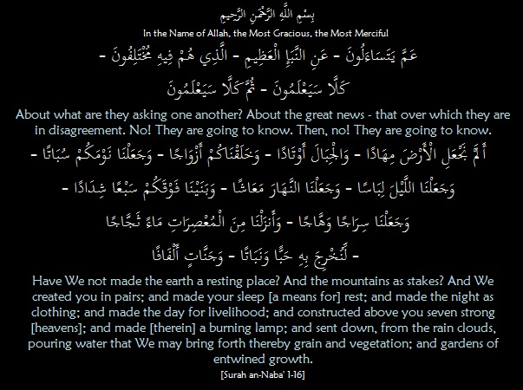
Tafseer of Surah al-Naba’:
Ayaat 1-16 – Proof of Allah’s Power and Ability to Resurrect the Dead

Slide 14
Tafseer of Surah al-Naba’:
Ayaat 1-16 – Proof of Allah’s Power and Ability to Resurrect the Dead
The Surah does not provide any more details about the event in question rather a threat is given, “No! They are going to know. Then, no! They are going to know,”. The Arabic term, kalla, denotes strong shunning. The repetition of the entire sentence adds force to the threat implied.
The Surah then puts aside, apparently, that great event only to pick it up later on. We are then taken on a quick round of the universe in which we see a multitude of scenes, creatures and phenomena. Contemplation of which strongly shakes any human heart. Which provide strong evidence of the deliberate planning and designing which go into their creation.
It takes us across the earth and the mountains, “And We created you in pairs,” meaning, male and female so that procreation is achieved. “And made your sleep [a means for] rest,” meaning a cessation of movement in order to attain rest from the frequent repetition and going about in search of livelihood during the day. “And made the night as clothing,” meaning, its shade and darkness covers the people. The day, on the other hand has been made radiant, luminous, and shining so that the people would be able to move about in it. By it there are able to come and go for their livelihood, earning, business dealings and other than that as well. “And constructed above you seven strong [heavens],” Sun is like a shining lampوَهَّاجًا giving light and heat to the entire world. It also plays an important part in forming the clouds by evaporating sea water. This is how grains, vegetables, bushes and wide-branching trees grow.

Slide 15
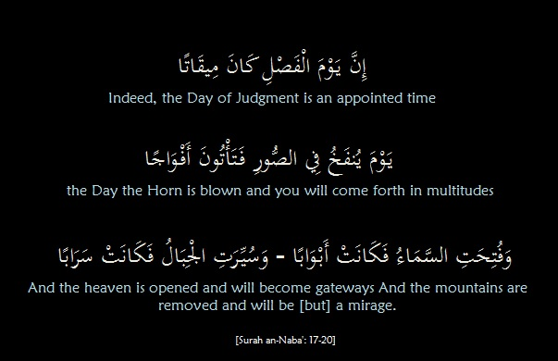
Tafseer of Surah al-Naba’
Ayaat 17-20 – Indeed, the Day of Judgment is an Appointed Time

Slide 16
Tafseer of Surah al-Naba’
Ayaat 17-20 – Indeed, the Day of Judgment is an Appointed Time
Creation is not without purpose. The Creator, who has accurately measured human life and carefully provided perfect harmony between it and the universe, will not let people just live and die in vain. Reason cannot accept that those who do good and the evildoers should both end in dust. The rightly-guided and the straying folk, the just and the tyrants cannot all share the same fate. There must be a day when everything is judged and evaluated. “Indeed, the Day of Judgment is an appointed time,” It is a day when upheaval overtakes the universe and destroys its systems, “the Day the Horn is blown and you will come forth in multitudes,”
All in all, horror is apparent in the upheaval which envelops the universe as well as in men’s resurrection after the Trumpet is blown. Such is the Day of Decision carefully and wisely fixed.

Slide 17
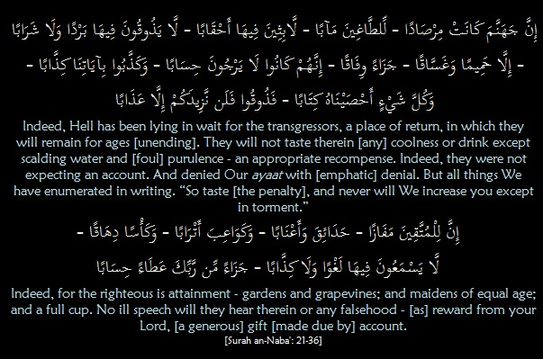
Tafseer of Surah al-Naba’
Ayaat 21-36 – Reward and Reckoning

Slide 18
Tafseer of Surah al-Naba’
Ayaat 21-36 – Reward and Reckoning
The Surah takes another step, beyond Resurrection, to describe the fate of the tyrant unbelievers and also that of the righteous. It begins with the former group who raise doubts about the fateful tiding, “Indeed, Hell has been lying in wait for the transgressors, a place of return, in which they will remain for ages [unending],”
“Indeed, they were not expecting an account. And denied Our ayaat with [emphatic] denial.” Their denial, as the Arabic text suggests, is strongly emphatic and stubbornly upheld. But Allah subhanahu wa ta’ala keeps a meticulous record which does not leave out anything they do or say, “But all things We have enumerated in writing,” “So taste [the penalty], and never will We increase you except in torment.”
We then have the corresponding scene of the righteous in complete bliss, “Indeed, for the righteous is attainment,” If hell is a vigilant watch guard which the tyrants cannot escape, the righteous, the God-fearing will end in a place of security. What a place it is: “gardens and grapevines.” The vine tree is specifically mentioned because it is well known to the addressees. The God-fearing will also have companions who are described here as high-bosomed and of equal age.
These luxuries are given a physical description so that we may better appreciate them. It is a pure life there. The reality is known to everyone, which means that there is no room for futile argument. Then follows the Qur’anic comment, “reward from your Lord”.

Slide 19
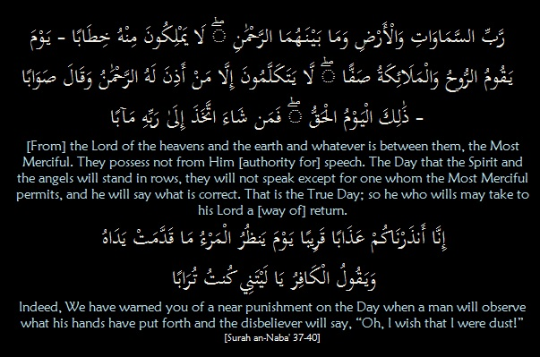
Tafseer of Surah al-Naba’
Ayaat 37-40 – Man will Wish He was Dust

Slide 20
Tafseer of Surah al-Naba’
Ayaat 37-40 – Man will Wish He was Dust
The Surah closes with the final scene of the Day when all this happens. It is a scene in which we see the angel Jibreel ‘alayhi salaam and all the angels standing in ranks before Allah subhanahu wa ta’ala, their Most Merciful Lord. They stand in awe of Him; no one dares utter a word without prior permission from Him.
The Surah therefore delivers a warning to those who have chosen not to hear or see, “That is the True Day.” There is no room left for doubt and controversy. Yet there is time for mending one’s erring ways before the fearful watch guard, i.e. hell, becomes a permanent home, “so he who wills may take to his Lord a [way of] return.”
“Indeed, We have warned you of a near punishment,” meaning it will not be long coming, for man’s life is but a short period. The scourge is so fearful that the unbelievers, when faced with it, will send up that great cry expressing the wish that they had never lived, “on the Day when a man will observe what his hands have put forth and the disbeliever will say, ‘Oh, I wish that I were dust!’” This is the cry of one who is in great distress, who feels ashamed for what he has been and what he has done. He feels that it is better not to be, or to be something as worthless as dust, than to witness such a fearful occasion.

Slide 21
Discussion
Why is this surah named an-Naba (the Great News) and what is its theme?
How it makes proof of Allah’s Power and Ability to Resurrect the Dead?
Why Man will Wish He was Dust?

