Slide 1
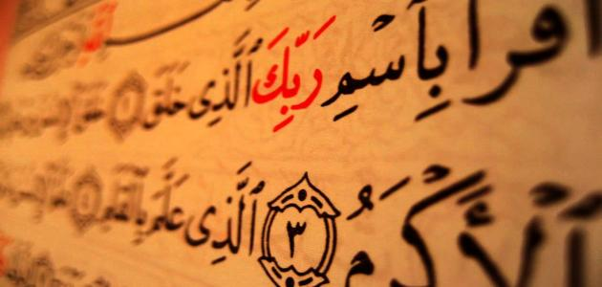
The Stages the Quran has passed through to reach us
Dr. Ashraf Negm

Slide 2
Agenda
The transmission of the whole revelation at once
The revelation in segments
Compiling the Quran in front of the Prophet (PBUH)
Collecting the Quran during the reign of Abu Bakr al-Siddique
Collecting the Quran during the reign of Uthman Ibn-Affan

Slide 3
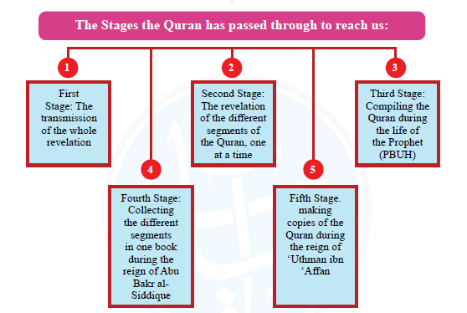

Slide 4
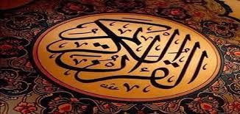
First Stage: The transmission of the whole revelation

Slide 5
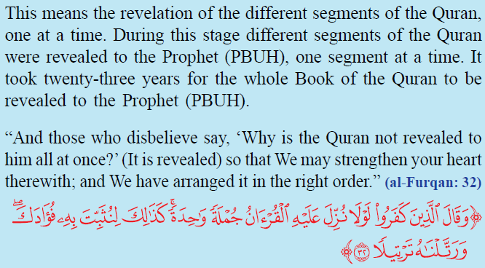
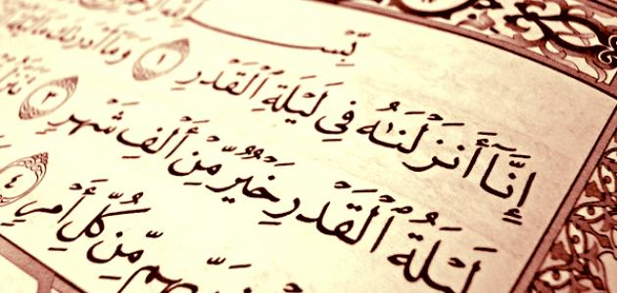
Second Stage: The revelation of the different segments of the Quran, one at a time

Slide 6
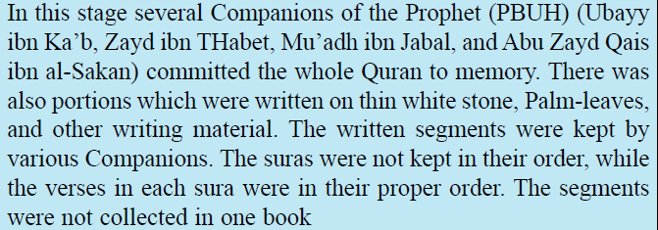
Third Stage: Compiling the Quran during the life of the Prophet (PBUH)

Slide 7
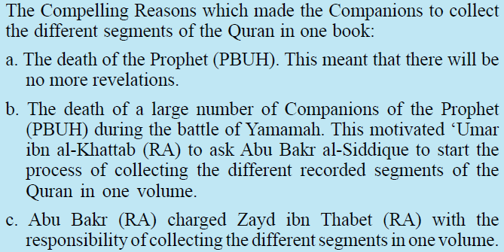
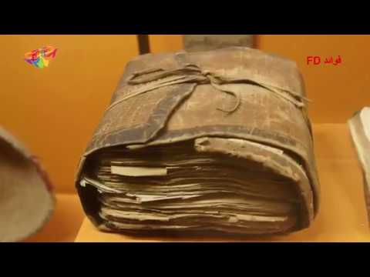
Fourth Stage: Collecting the different segments in one book during the reign of Abu Bakr al-Siddique

Slide 8
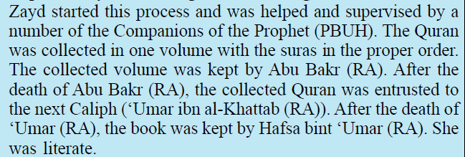
Fourth Stage: Collecting the different segments in one book during the reign of Abu Bakr al-Siddique

Slide 9
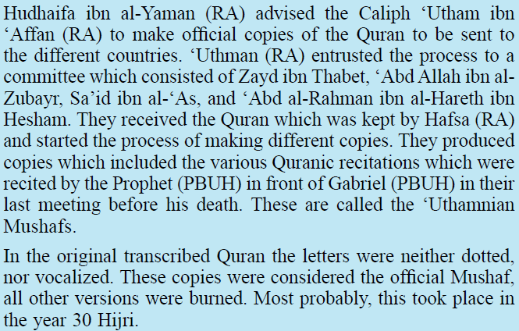
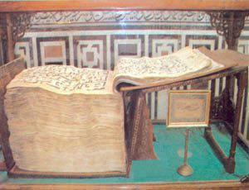
Fifth Stage: Making copies of the Quran during the reign of ‘Uthman ibn ‘Affan

Slide 10
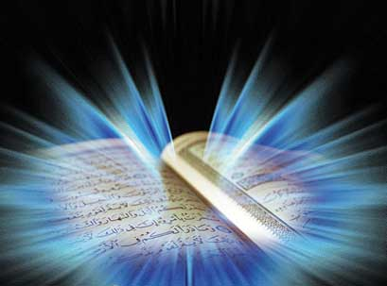
والله من وراء القصد
وهو يهدي السبيل
Jazakom Allah Khairan

