Slide 1
TAFSEER
QRN 111 – Tafsir Curriculum – Lecture No. 6
Imam Adnan Balihodzic
First Semester
1442H/2020

Slide 2
Agenda
Lecture No. 6
Tafseer of Surah Al-Mutaffifeen (no. 83nd)

Slide 3
Tafseer of Surah Al-Mutaffifeen
Name- It is derived from from the word in the first verse: al-muṭaffifeen (Those Who Deal in Fraud/Defrauders/Stinters).
Period of Revelation- The style of the Surah and its subject matter clearly show that it was revealed in the earliest stage at Makkah, when surah after surah was being revealed to impress the doctrine of the Hereafter on the people's minds. This Surah was revealed when they had started ridiculing the Muslims and disgracing them publicly in the streets and in their assemblies, but persecution of the Muslims had not yet started.
Some commentators regard this as a Madani Surah. This misunderstanding has been caused by a tradition/hadith from Ibn Abbas according to which when the Prophet (upon whom be peace) arrived in Madinah, the evil of giving short weight and measure was widespread among the people there. Then Allah sent down Wayl ul-lil mutaffifin and the people began to give full weight and measure. (Nasa'i, Ibn Majah, Ibn Marduyah, Ibn Jarir, Baihaqi: Shu`ab-il-Iman)
But, the common practice with the Companions and their successors was that when they found that a verse applied to a certain matter of life, they would say that it had been sent down concerning that particular matter. Therefore, what is proved by the tradition of Ibn Abbas is that when after his emigration to Madinah the Prophet saw that the evil was widespread among the people there, he recited this Surah before them by Allah's Command and this helped them mend their ways.
Theme and Subject Matter- The Akhirah/Hereafter.

Slide 4
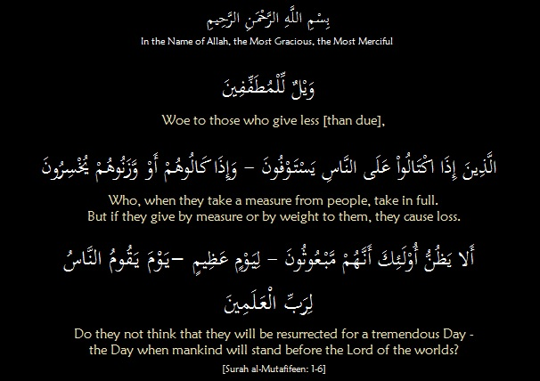
Tafsir of Surah Al-Mutaffifeen: Ayaat 1-6 – Dishonesty in Business a Cause of Regret in the Hereafter

Slide 5
Tafsir of Surah Al-Mutaffifeen: Ayaat 1-6 – Dishonesty in
Business a Cause of Regret in the Hereafter
At the beginning of this sūrah, Allah (The Almighty) declares war against those who cheat others and take their rights. The Arabic term ‘Wayl’ (woe) implies destruction and ruin. Al-muṭaffifeen are those who are stingy when dealing in weight or measurement with the intent to gain some small profit unlawfully, as explained in Āyahs 2 and 3: “when they take a measure from people take in full,” but “if they give by measure or by weight to them, they cause loss,” meaning they decrease. So Mutafiffeen are those who want their merchandise complete and intact when they buy, but who do not give the right amount when they sell. But instead of advantage, their Lord has promised them devastation and destruction, which is what is meant by "wayl.'‘ The people of Shu’aib were destroyed and wiped out because of their cheating in weights and measurements. In spite of Prophet Shu’aib ‘alayhi salaam’s counsel and advice they did not refrain from it.
The following three ayaat wonder at the defrauders, who behave as if they will not have to account for what they gain in this life: “Do they not think that they will be resurrected for a tremendous Day – the Day when mankind will stand before the Lord of the worlds?” Allah, the Mighty and Majestic, warns all those who would deprive others of their right, even when it is so little as not to be noticed. Do such people not fear the resurrection and standing for account before their Creator, who knows every concealed matter and every innermost secret? It will be a Day full of terror, anxiety and dread; and whoever is convicted on that Day will be driven into the blazing Hellfire. All people are being reminded here that they will indeed be re-created for the Day of Judgement, when each of them will stand individually, helpless and exposed before Allah.

Slide 6
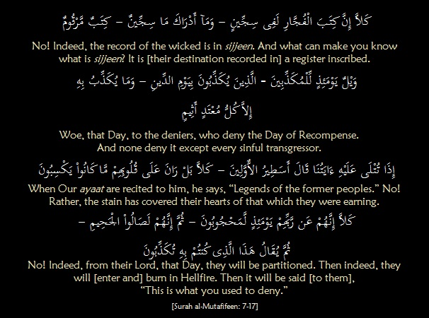
Tafsir of Surah Al-Mutaffifeen: Ayaat 7-17
– The Inevitable Reckoning

Slide 7
Tafsir of Surah Al-Mutaffifeen: Ayaat 7-17
– The Inevitable Reckoning
The Surah proceeds to describe the standing of this group before Allah, their situation in this life, and what awaits them on the great day. They think they will not be raised to life after death, so the Qur’an rebukes them and affirms that a record of their actions is kept. There is no possibility of addition or omission until it is thrown open on that great day. The location of that record is specified as an additional confirmation of the fact, albeit a location unknown to man. They are threatened with woe and ruin on that day when their record shall be reviewed: “No! Indeed, the record of the wicked is in sijeen. And what can you know what is sijeen? It is [their destination recorded in] a register inscribed,”.
No, it is not as they think; they will surely be called to account. It is written in their records that the destination of sinners and criminals will be sijjeen, the deepest depths of Hell. It may be understood as well that their record is located there. It is already inscribed – written and completed; no one can add anything to it or remove anything from it. The record will remain unopened until the Day of Account.
In addition to al-muṭaffifeen, Allah promises destruction and devastation on the Day of Recompense to those who had denied its occurrence while on earth. The wicked, as the Arabic term, fujjar, here connotes, are those who indulge excessively in sin. Their final destination will be in sijeen which is derived from the word prison (sijn), and here it means straitened circumstances. Thus, Allah expresses the greatness of this matter, meaning it is a great matter, an eternal prison, and a painful torment.

Slide 8
Tafsir of Surah Al-Mutaffifeen: Ayaat 7-17
– The Inevitable Reckoning
“Woe on that Day to the deniers. Those who deny the Day of Reckoning.” In the next ayaat we are given information about the subject of unbelief, and the true character of the unbelievers who deny the Day of Judgment: “And denies it except every sinful transgressor. When Our ayaat are recited to him, he says, ‘Legends of the former people,’”.
Aggression and bad deeds lead the perpetrators to deny the Day of Judgment and to take a rude and ill-mannered attitude towards the Qur’an, describing it as “Legends of the former people.” This description by the unbelievers is, of course, based on the fact that the Qur’an contains some historical accounts of former nations. These accounts are related as a lesson for later generations as they demonstrate with much clarity the working of the divine rules to which all nations and generations are subject.
They are strongly rebuked and reprobated for their rudeness and rejection of the truth. This is implied by the Arabic term kalla, translated here as ‘No! Indeed’, which is an assertion that their allegations are unfounded: “But no! Their hearts have become corroded by what they used to commit.”

Slide 9
Tafsir of Surah Al-Mutaffifeen: Ayaat 7-17
– The Inevitable Reckoning
We are then given an insight into the motives of their insolent disbelief and the reasons for their inability to see the obvious truth or respond to it: “the sin has covered their hearts.” Indeed the hearts of those who indulge in sin become dull, as if they are veiled by a thick curtain which keeps them in total darkness, unable to see the light. Thus they gradually lose their sensitivity and become lifeless. . The verb, rāna indicates that the heart became corroded or covered with rust, stain or dirt.
The Prophet salAllahu ‘alayhi wa sallam said, “Verily! When a man commits a sin, it throws a black spot over his heart. If he repents, his heart is polished; but if he persists in his practice, the stains increase.” [Ibn Jareer, at-Tirmidhī, al-Nasai and Ibn Majah.] Explaining this ayah, Hasan Basri said, “It is a case of one sin on top of another until the heart is blinded and dies.”
Then we are told what will happen to them on that great day. No, it is not as they think; they will surely be called to account. “No! Indeed from their Lord, that Day, they will be partitioned/screened. Then indeed, they will [enter and] burn in Hellfire. Then it will be said [to them], ‘This is what you used to deny’”.
Because their sins have cast a thick veil over their hearts, they are unable in this life to feel Allah’s presence, and it is only appropriate that they not be allowed to see His glorious face. They will be deprived of this great happiness, which is bestowed only on those whose hearts and souls are so clean and transparent. This separation from their Lord is the greatest and most agonizing punishment and deprivation. It is a miserable end of man.

Slide 10
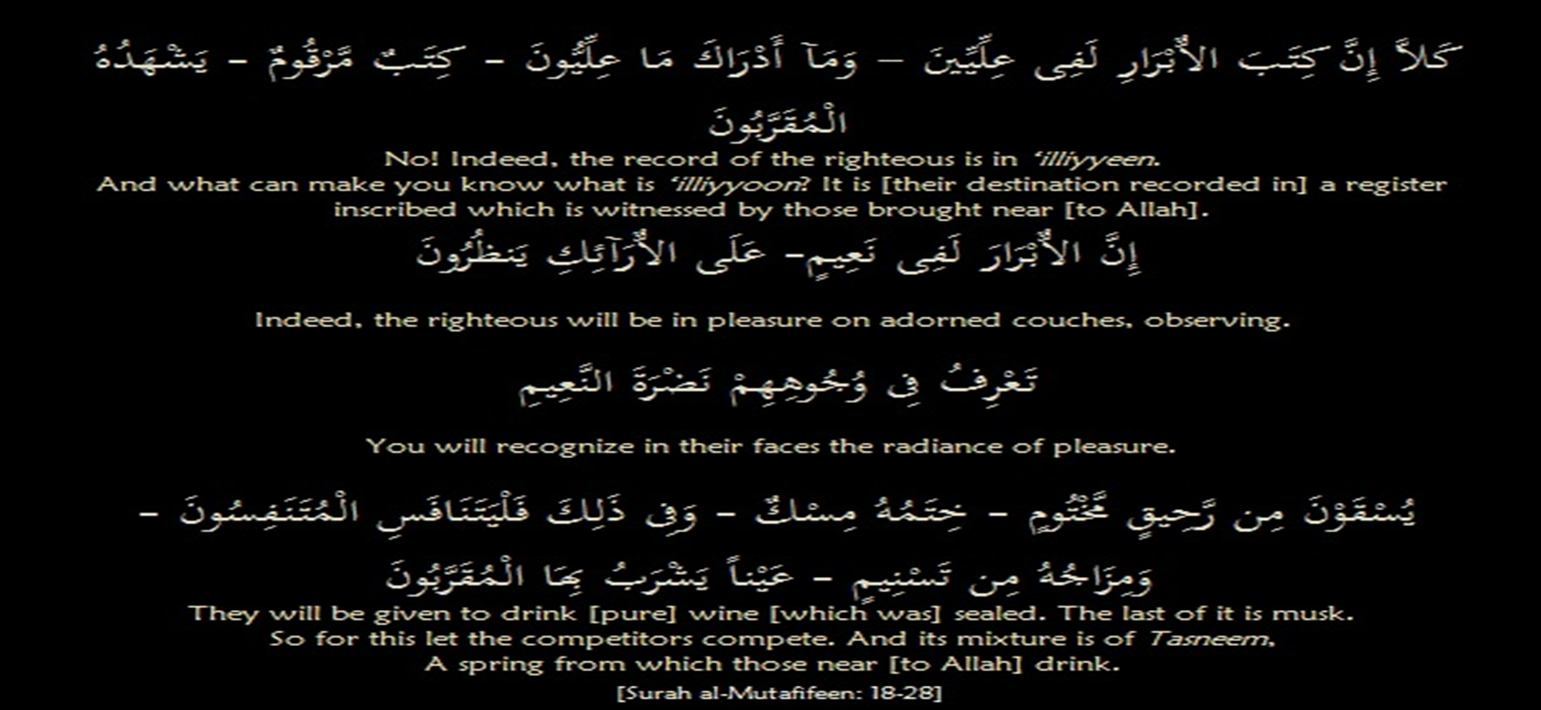
Tafsir of Surah Al-Mutaffifeen:
Ayaat 18-28 – Faces Radiant with Joy

Slide 11
Tafsir of Surah Al-Mutaffifeen:
Ayaat 18-28 – Faces Radiant with Joy
Then follows an account of the other group – the righteous. This is given in the customary Qur’anic manner of providing two elaborately contrasting images, so that a detailed comparison may be drawn.
This section of the Surah starts with kalla, which connotes strong reproach and a firm command to the transgressors to desist from their rejection of the truth. Kallā again refutes the claim that people will not stand before Allah for account in the Hereafter. It then proceeds to speak about the righteous. “No indeed. The record of the righteous is in Elliyyeen.” Since the record of the transgressors is in sijeen, that of the righteous is in ‘illiyyeen. The term ‘righteous’ refers to the obedient who do good. They are the exact opposite of the transgressors, who indulge in every excess.
Term ‘illiyyeen is taken from the word ‘uluw which means highness. The more something ascends and rises, the more it becomes greater and increases. Thus, Allah magnifies its status by saying, “And what can make you know what is ‘illiyyoon?”
The Surah then states that the book of the righteous is a record inscribed, witnessed by those who are closest to Allah. The angels closest to Allah see this book and witness it. This statement gives the feeling that the record of the righteous is associated with nobility, purity and sublimity. The angels closest to Allah look at it and enjoy its description of noble deeds and glorious characteristics. The whole image provides evidence of the honor the righteous receive.

Slide 12
Tafsir of Surah Al-Mutaffifeen:
Ayaat 18-28 – Faces Radiant with Joy
Then follows an account of the situation in which the righteous find themselves, “Indeed, the righteous will be in pleasure/bliss”. This contrasts with hell, in which the transgressors dwell. The righteous will be given a place of honor and will live in mental and physical comfort. They will be in eternal pleasure and gardens that contain comprehensive bounties. “On luxurious furnishings/couches, gazing around.” They will be gazing at their kingdom and what Allah has given them that will not end or perish. ”You will recognize on their faces the radiance of bliss.” Their faces will be radiant with unmistakable joy.
“They will be given to drink of pure sealed wine.” They will be given drink from the wine of Paradise. The word, ar-Raheeq that appears in the ayah is one of the names of the wine in Paradise. The fact that this wine will be sealed with musk as denoted by khitamu-hu misk in itself increases the value of this drink. It will be served by the attendants of Paradise to the dwellers of Paradise. This drink will be mixed with a delicious drink from a spring called Tasneem – a spring for those who are closest to Allah.
To get all of this Allah says, “So for this let the competitors compete.”

Slide 13
Tafsir of Surah Al-Mutaffifeen:
Ayaat 18-28 – Faces Radiant with Joy
Everyone is competing for something in this world. The defrauders, hardened by their sins and excesses, strive endlessly for the petty riches of this world. Each of them tries to outdo the others and gain as much as possible. Hence, he indulges in all types of injustice and vice for the sake of ephemeral luxuries.
Those who strive for an object of this world, no matter how superb, grand or honorable it is, are in reality striving for something hollow, cheap and temporary. This world, in its totality, is not worth, in Allah’s view, one mosquito’s wing. It is the other type of luxury and honor which deserves zealous striving – the treasures and comforts of Jannah.
It is remarkable that striving for the Hereafter elevates the souls of all strivers, while competition for worldly objects sinks the competitors’ souls to the lowest depths.
The statement, “So for this let the competitors compete,” inspires man to look far beyond this finite, little world, as he sets out to fulfill his mission as Allah’s vicegerent on earth. Man’s life on earth is limited while his future life is of limitless duration. The luxuries of this world are also limited while the happiness of paradise is much too great for us to conceive. What comparison can then hold between the two spheres of competition or the two goals? It is, indeed, one race and a single competition: “So for this let the competitors compete.”

Slide 14
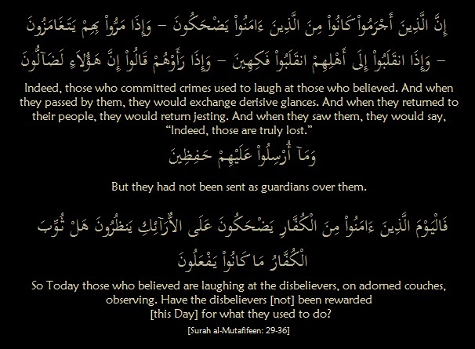
Tafsir of Surah Al-Mutaffifeen:
Ayaat 29-36 – Stark Contrast

Slide 15
Tafsir of Surah Al-Mutaffifeen:
Ayaat 29-36 – Stark Contrast
The final comment of the Surah contains a subtle satire. The images portrayed by the Qur’an of the evildoers’ derision of the faithful, their rudeness and insolence, and their description of the faithful, as having ‘gone astray’ happen over and over again in all ages and places. Many people in our own age have witnessed similar actions. This proves that the attitude of the transgressors and the evildoers to the believers hardly ever changes.
“Indeed, those who committed crimes used to laugh at those who believed,” The believers were made to suffer ridicule and derision by the transgressors, either because they were poor or weak or because their self-respect would not allow them to return the abuse of base evildoers. What a contrast: the evildoers persecute the believers and laugh at them shamelessly while the believers stick to dignified self-respect and perseverance.
“And when they passed by them, they would exchange derisive glances,” They wink at one another or make certain actions intended as mockery and derision trying to embarrass the helpless believers.
“And when they returned to their people, they would return jesting,” When they have nourished their evil minds with such mockery and injurious actions they go back to their own folk to continue their laughter and derision. They are satisfied with what they have done. Although they have sunk to the lowest depths, they cannot imagine how contemptible they are.

Slide 16
Tafsir of Surah Al-Mutaffifeen:
Ayaat 29-36 – Stark Contrast
“And when they saw them, they would say, ‘Indeed, those are truly lost!’” Nothing is more absurd than being told by the transgressors what is right and wrong. Transgression knows no limits. The transgressors never feel ashamed of what they do or say. Their description of the believers as having gone astray is a clear manifestation of this fact. The Qur’an criticizes, however, those who involve themselves impudently in something which does not concern them, “…they had not been sent as guardians over them,” No one has asked them to look after the believers, or to watch over them, or to assess their situation. So why do they give their unsolicited opinion?
Who Laughs at Whom? The Muslim minority in Makkah was facing a sustained, demoralizing onslaught by the unbelievers, but Allah did not leave the Muslims on their own: He comforted them and urged them to persevere. They are comforted by the very fact that their sufferings are being noticed by Allah. He sees what the believers suffer and does not ignore what He sees, although He may let the unbelievers do as they wish, if only for a while. He also sees how the transgressors laugh unrepentantly at the sufferings of the faithful. This, in itself, is enough consolation for the believers.
As we read in ayaat 7-17, on the Judgment Day the tables will be turned. Those who are being made fun of because of their righteousness will be reclining of couches and will be served a drink sealed with musk while those who mocked would be burning in fire.
The Surah concludes with a satirical question, “Have the disbelievers [not] been rewarded [this Day] for what they used to do?” Their punishment is sarcastically described as reward.

Slide 17
Discussion
What is the meaning of al-muṭaffifeen?
What is the meaning of (rana) in the surah?
What is al-Raḥeeq and what the Tasneem.

