Slide 1
HADEETH
HAD 121 – Hadeeth Curriculum – Lecture No. 2
Imam Adnan Balihodzic
First Semester
1442H/2020

Slide 2
Agenda
Lecture No. 2
Pillars of Islam
Articles of Iman
Ihsan
Signs of the Hour

Slide 3
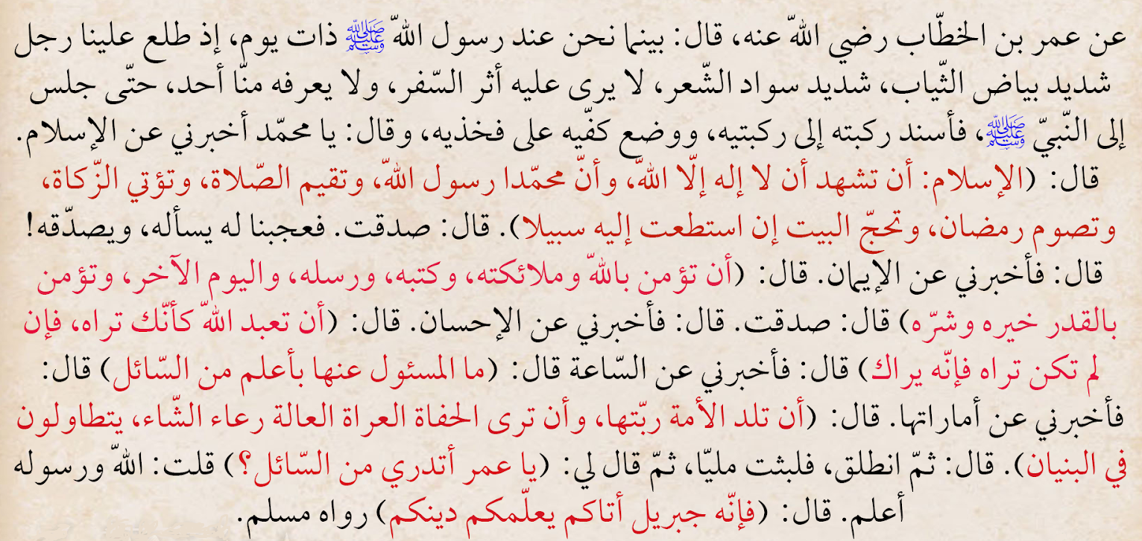
Hadeeth #2:

Slide 4
Hadeeth #2:
Also on the authority of Umar ibn al-Khattab (may Allah be pleased with him), who said: One day while we were sitting with the Messenger of Allah (peace and blessings of Allah be upon him) there appeared before us a man whose clothes were exceedingly white and whose hair was exceedingly black; no signs of journey were to be seen on him and none of us knew him. He walked up and sat down in front of the Prophet (peace and blessings of Allah be upon him), with his knees touching against the Prophet’s (peace and blessings of Allah be upon him) and placing the palms of his hands on his thighs he said, “O Muhammad, tell me about Islam.”
The Messenger of Allah (peace and blessings of Allah be upon him) said, “Islam is to testify that there is no deity worthy of worship but Allah and Muhammad is the Messenger of Allah, to perform prayers, to give zakat, to fast in Ramadhan, and to make the pilgrimage to the House if you are able to do so.”
He said, “You have spoken rightly”; and we were amazed at him asking him and saying that he had spoken rightly.

Slide 5
Hadeeth #2:
He [the man] then said, “Tell me about Iman.”
The Prophet (peace and blessings of Allah be upon him) said, “It is to believe in Allah, His Angels, His Books, His Messengers, and the Last Day, and to believe in divine destiny (qadr ), both the good and the evil of it.” He said, “You have spoken rightly.”
He [the man] said, “Then tell me about Ihsan.”
The Prophet (peace and blessings of Allah be upon him) said, “It is to worship Allah as though you see Him, and if you do not see Him, then (knowing that) truly He sees you.”

Slide 6
Hadeeth #2:
He said, “Then tell me about the Hour.”
The Prophet (peace and blessings of Allah be upon him) said, “The one questioned about it knows no better than the questioner.”
He said, “Then tell me about its signs.”
The Prophet (peace and blessings of Allah be upon him) said, “That the slave-girl will give birth to her mistress, and that you will see barefooted, naked destitute shepherds competing in constructing lofty buildings.”
Then he [the man] left, and I stayed for a time. The he [the Prophet (peace and blessings of Allah be upon him)] said, “O Umar, do you know who the questioner was?” I said, “Allah and His Messenger know best.”
He said, “It was Jibreel, who came to teach you your religion.”

Slide 7
Hadeeth #2: Pillars of Islam, Iman & Ihsan, and Signs of the Hour
Importance of this hadeeth
This is one of the most comprehensive hadeeths of the Prophet (peace be upon him). It touches upon almost every deed of Islam.
Qaadhi Iyaadh has pointed out that this hadeeth covers or points to all of the aspects of inward and external acts of worship of Allah. Indeed, he stated, "[It covers the religion] to such an extent that all the religious sciences are found in it and branch out from it."
Hence, some of the scholars have termed this hadeeth Umm al-Sunnah (or "Mother or Core or Foundation of the Sunnah") in the same way that Soorah al-Faatiha is called Umm al-Kitaab (or "Mother or Core or Foundation of the Book").
This hadeeth is also known as Hadeeth Jibreel (Angel Gabriel) (as).

Slide 8
Hadeeth #2: Pillars of Islam, Iman & Ihsan, and Signs of the Hour
Vocabulary
Deity, Arabic (ilaah) – a god, object of worship.
"the Hour", Arabic (as-Sa’ah) - here it is in reference to the Day of Judgment although the word is general meaning "hour" or a portion of time.
Mistress – a woman who has authority, control, or power.
Lofty – extending high in the air; towering.

Slide 9
Hadeeth #2: Pillars of Islam, Iman & Ihsan, and Signs of the Hour
Explanation of this Hadeeth
“While we were one day sitting with the Messenger of Allah (peace be upon him) there appeared before us a man dressed in extremely white clothes and with very black hair. No traces of journeying were visible on him, and none of us knew him. He sat down close by the Prophet (peace be upon him) rested his knees against the knees of the Prophet (peace be upon him) and placed his palms over his thighs”
As we know from the end of this hadeeth, the man who is described here is actually the angel Jibreel appearing in the form of a bedouin Arab.

Slide 10
Hadeeth #2: Pillars of Islam, Iman & Ihsan, and Signs of the Hour
“and said: "O Muhammad! Inform me about Islam." The Messenger of Allah (peace be upon him) replied:
"Islam is that you should testify that there is no deity worthy of worship except Allah and that Mohammad (peace be upon him) is Allah’s Messenger,
that you should perform Salah (Namaz, Prayer),
pay the Zakah (obligatory charity),
fast during Ramadan,
and perform Hajj (pilgrimage) to the House (the Kabah/Qiblah at Makkah), if you can find a way to it (or find the means for making the journey to it).”
“Man said: "You have spoken the truth." We were astonished at this thus questioning him (peace be upon him) and then telling him that he was right.”

Slide 11
Hadeeth #2: Pillars of Islam, Iman & Ihsan, and Signs of the Hour
“but he went on to say, "Inform me about Iman (faith).” "The Prophet (saws) answered, "It is that you believe in:
Allah, (in the Oneness of Allah, that He alone is the Lord (al-Rabb) and the sole Creator, only One worthy of worship, with all the names and attributes of Allah)
His Angels, (created from light)
His Books, (the revelations that were sent down to His messengers as a mercy and guidance to mankind)
His Messengers, (humans chosen by Allah to receive revelation from Him, and pass it on to the people)
the Last Day, (‘The Day of Resurrection’, ‘The Reality’, ‘The Overwhelming’, ‘The Event’ and ‘The Day of Judgement’)
and in Fate/Divine destiny (al-Qadar), both in its good and in its evil aspects." (Allah has knowledge of everything, and everything happens according to His decree and Will, recorded in the Preserved Tablet (al-Lawh al-Mahfoodh) He said, “You have spoken rightly.”

Slide 12
Hadeeth #2: Pillars of Islam, Iman & Ihsan, and Signs of the Hour
"Then the man said, "Inform me about Ihsan“
Ihsaan (perfection, excellence) is a very comprehensive term that incorporates in its meaning all types of goodness and using all our faculties in the best possible way for the best possible purpose.
"The Prophet (peace be upon him) answered, "It is that you should worship/serve Allah as though you could see Him, for though you cannot see Him yet He sees you."
‘Worship’ relates to all the acts that a person performs, both inward and outward, which should all be carried out with complete servitude to Allah swt.

Slide 13
Hadeeth #2: Pillars of Islam, Iman & Ihsan, and Signs of the Hour
The man said, "Inform me about the Hour (the Day of Judgment)." Prophet (peace be upon him) said, "About that the one questioned knows no more than the questioner."
The Prophet’s (peace be upon him) response shows that the knowledge of Day of Judgment is something that Allah kept to Himself and has not conveyed to anyone.
"So the man said, "Well, inform me about its signs.“ Prophet (peace be upon him) said, "They are that the slave-girl will give birth to her mistress." (children will disobey their mothers, treating them like a slave-girls)
"and that you will see the barefooted ones, the naked, the destitute, the herdsmen of the sheep (competing with each other) in raising lofty buildings.“ (those not qualified will be in charge, and as a result they will squander wealth with extravagance)
"There upon the man went off. I waited a while, and then he (the Prophet) said, "O `Umar, do you know who that questioner was?" I replied, "Allah and His Messenger know better." He said, "That was Jibril. He came to teach you your religion."

Slide 14
Hadeeth #2: Pillars of Islam, Iman & Ihsan, and Signs of the Hour
Lessons from this Hadeeth
Prophet, saws, defines Al-Islam, i.e. the five pillars, as the outward actions of the limbs, Al-Iman as being associated with belief - the inner actions of the heart, and Al-Ihsan as the highest level to attain (that we become concerned about the quality of our deeds, and not simply their quantity or outward execution).
The Prophet, saws, described at the end of this hadeeth what the Angel Jibreel taught as being the deen, or religion, of Islam which consists of these three aspects.
This hadeeth teaches the adab (ethics) of seeking knowledge.
The signs of the Last day mentioned in this hadeeth are minor signs, as opposed to major ones.
Conclusion:
This hadeeth contains everything about Islam: the five pillars of Islam, the beliefs that make up Iman (including the belief of fate or qadar), the attainment of the highest level of Iman which is Ihsan, the adab of seeking knowledge and of teaching.

Slide 15
Hadeeth #2: Pillars of Islam, Iman & Ihsan, and Signs of the Hour
Discussion:
What is the importance of this hadeeth?
What does Deen consist of, and what Imaan, according to this hadeeth?
What are the signs of the Hour (the Day of Judgment) mentioned in this hadeeth, with short explanation?

