Slide 1
TAFSEER
QRN 111 – Tafsir Curriculum – Lecture No. 8
Imam Adnan Balihodzic
First Semester
1442H/2020

Slide 2
Agenda
Lecture No. 8
Tafseer of Surah al-Burooj (no. 85th) from verse 10.
Tafseer of Surah at-Tariq (no. 86th)

Slide 3
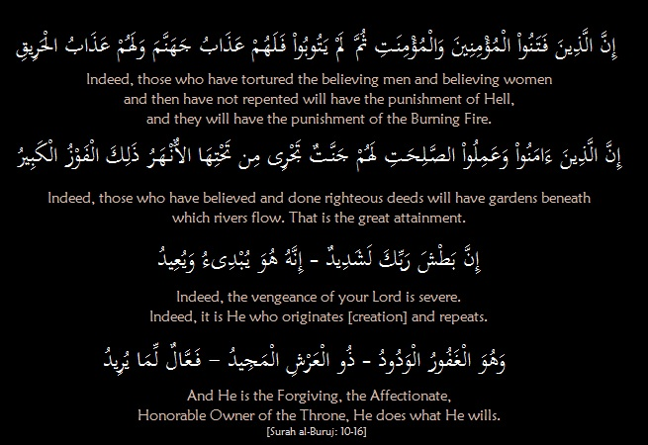
Tafseer of Surah al-Burooj: Ayaat 10-16 - Different Paths Different Destinies

Slide 4
Tafseer of Surah al-Burooj: Ayaat 10-16 - Different Paths Different Destinies
“Indeed, those who have tortured the believing men and believing women and then have not repented will have the punishment of Hell, and they will have the punishment of the Burning Fire.” What happens on earth in this first life is not the end of the story. There remains the allocation of awards, which will restore the balance of justice and provide the final settlement of what took place between the believers and the tyrants.
Those who persecute the believing men and women and persist in their evil ways without repenting shall suffer the punishment of hell-burning. Burning is specifically mentioned because it serves as a counterpart to the burning in the pit. Recompense is based upon the type of deed performed.
“Indeed, those who have believed and done righteous deeds will have gardens beneath which rivers flow. That is the great attainment.” Paradise symbolizes Allah’s pleasure with righteous believers and His reward to them. The Arabic term, fawz, used here for triumph also connotes escape and success. Escaping the punishment of the Hereafter is the real success. Whatever trials you are going through because of your belief in Allah will pass, the Hereafter is where you are going to remain forever and that should remain your main focus.

Slide 5
Tafseer of Surah al-Burooj: Ayaat 10-16 - Different Paths Different Destinies
“Indeed, the vengeance of your Lord is severe.” This comment suitably contrasts Allah’s punishment with the vengeance of the tyrants that they consider to be powerful. “It is He who begins and repeats.” The real power is that leveled by the Almighty not that leveled by insignificant people who impose their rule over a limited piece of land for a limited period of time over weak people. This statement also serves as an assurance for the believers who have believed in One Allah and are afflicted because of their belief.
But those who humble themselves and repent, for them, “He is the Forgiving, the Affectionate.” Hasan Al-Basri said, “Look at this generosity and kindness. These people killed Allah’s Awliya’ and He still invites them to make repentance and seek forgiveness.” Forgiveness is part of Allah’s mercy and grace which have no limits or restrictions. It is an open door which is never closed no matter how grave a sin is. “Possessor of the Glorious Throne. Doer of whatever He wills.”
“Has there reached you the story of the soldiers – [Those of] Pharaoh and Thamud?” This is a reference to two long stories well-known to the addressees as they have been mentioned several times in the Qur’an. Have you heard their stories and how Allah dealt with them?

Slide 6
Tafseer of Surah al-Burooj: Ayaat 17-22- Those who Disbelieve are in Persistent Denial
Theirs were two stories, different in nature and consequence. Pharaoh and his army were eliminated when the Children of Israel were saved by Allah. As for the Thamud, Allah exterminated them and saved His prophet, Şalih, along with his few followers. The believers in this instance did not establish a state of their own; they were merely saved from corrupt enemies.
Both stories are manifestations of the divine will. They provide two examples of what may befall advocates of the Islamic faith. They are mentioned along with a third possibility which distinguishes the pit event. The Qur’an explains all three eventualities to the believers in Makkah and to all generations of believers.
The Surah concludes with two statements of fact and a final verdict: “But they who disbelieve are in (persistent) denial. While Allah encompasses them from behind.” The truth about the disbelievers is that they are in a constant state of disbelief, uttering lies morning and evening, but Allah surrounds them all. Unaware that Allah’s might and His knowledge engulf them.
“But this is an honored Qur’an.” The term honored signifies nobility and sublimity. Indeed, there is nothing nobler or more glorious than Allah’s word. It is inscribed on an imperishable tablet, the nature of which we cannot comprehend because it is part of the knowledge Allah has reserved for Himself. We benefit, however, that the Qur’an is well-preserved and well-guarded. It is the final word in every matter it deals with.

Slide 7
Tafseer of Surah at-Tariq
Name- from the word at-tariq in its first verse.
Period of Revelation- The style of its subject matter resembles that of the earliest Surahs revealed at Makkah. This sūrah was revealed at a time when the disbelievers of Makkah were using all possible strategies and tactics to obstruct and defeat the message of the Qurʼān and Prophet Muḥammad.
Theme and Subject Matter- The Surah discuses two themes: It deals with man's existence and development under the protection of his Creator and the return to Him for judgment. It concludes with a warning to the unbelievers that they will not be able to discredit the Qurʼān with their schemes and that they will ultimately be defeated.
Virtue of Surah at-Tariq
Once Mu’adh radhiAllahu ‘anhu lead the Maghrib prayer and he recited al-Baqarah and an-Nisa’. When the Prophet salAllahu ‘alayhi wa sallam found out he said, “Are you putting the people to trial O Mu’adh! Was it not sufficient for you to recite As-Sama’i wat-Tariq, and Ash-Shamsi wa Duhaha, and something like them?” [An-Nasai’]

Slide 8
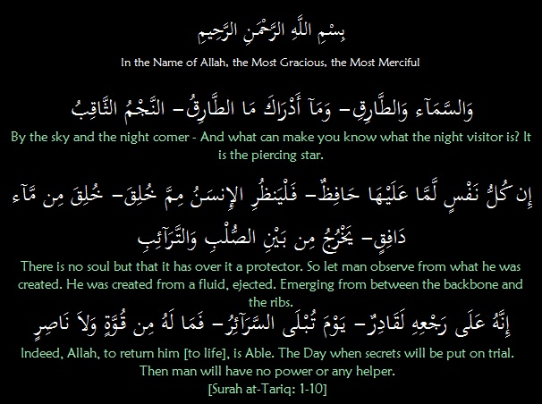
Tafseer of Surah at-Tariq: Ayaat 1-10 –
Every Soul has a Guardian over it

Slide 9
Tafseer of Surah at-Tariq: Ayaat 1-10 –
Every Soul has a Guardian over it
“By the sky and at-Tariq”. Allah swears by the heaven and by aṭ-ṭāriq, a star which knocks, beats or pulsates. A question is then posed to bring additional attention to its nature “But what will let you know what at-Tariq is?”, which is confirmed by the answer: “It is the piercing star”, one whose powerful rays pierce and penetrate through the darkness of night.
Allah swears by the sky and its pulsing, piercing star that every soul has over it a ḥāfith, an observer appointed by Him to watch and protect it. “There is no soul without a Protector over it.” This implies that every individual continues to exist due to the guardian protecting his soul, and in addition, that there is a record being kept. The soul is never unattended and cannot escape being observed. There are guardian angels and recording angels accompanying each person throughout life.
Allah then calls our attention towards the early stages of man’s creation, “So let man observe from what he was created,” Man is reminded of his humble origin: “He was created from gushing liquid, ejected” – that he is created from a liquid ejected from the body of the male or from that of both the male and female.

Slide 10
Tafseer of Surah at-Tariq: Ayaat 1-10 –
Every Soul has a Guardian over it
“Emerging from between the backbone and the ribs.” Ṣulb and tarāʼib express the two walls of the body, back and front, between which the reproductive organs are located.
Man is told to consider how he was brought into existence from a mere sperm drop and then shaped into a living, intelligent human being. Systematic development indicates a purpose, which is bound to continue. He is then told that the Creator who brought him and every other individual into existence most certainly has the power to create him once again in any way He pleases.
“The Day when secrets will be put on trial, then man will have no power or any helper,” This next creation will be for the purpose of judgment and compensation; subjecting everything which had remained concealed in the hearts of men to precise examination. All people will be brought to judgment. Not only their deeds, but their deepest secrets, motives and intentions will be uncovered, exposed and analyzed with complete justice.

Slide 11
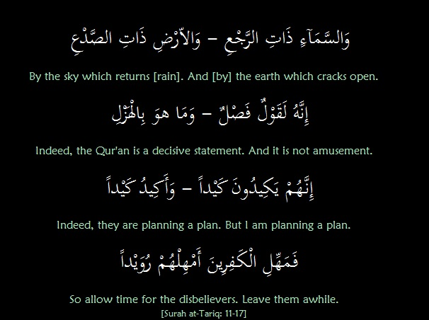
Tafseer of Surah at-Tariq: Ayaat 11-17 –
Qur’an is a Decisive Statement not Joke

Slide 12
Tafseer of Surah at-Tariq: Ayaat 11-17 –
Qur’an is a Decisive Statement not Joke
Allah swears once again, this time by the heaven and the earth. “By the sky that returns.” The sky is described as dhāt ar-rajʽ, more literally "having return." Ibn ʽAbbās said that ar-rajʽ means rain or rainclouds; the sky contains clouds which give rain, again and again, returning water to the earth. Qatādah added, "The sky returns people's sustenance each year; otherwise they and their cattle would die." The earth, dhāt aṣ-ṣadʽ then splits open to allow the sprouting of seeds and growth of plants.
“It is a Decisive Word. It is no joke/amusement.” The oath confirms and emphasizes that this Qur’ān is a decisive, conclusive and final word from Allah. It is not to be taken lightly. The truths expressed in it are not for the purpose of entertainment or diversion, but are firm and consistent facts which put an end to differences, doubts and uncertainties. It states with certainty that people will return to life to face a trial with judgment and recompense. Just as the falling of rain from the sky and the splitting of the earth is not jest but a serious reality, so is the news which the Qur’an gives that man has to return to his Creator. It puts an end to all arguments, doubts and uncertainties.

Slide 13
Tafseer of Surah at-Tariq: Ayaat 11-17 – Qur’an is a Decisive Statement not Joke
“Indeed, they are planning a plan/They plot and scheme. But I am planning a plan/I plot and scheme.” Allah has reassured His Messenger (PBUH) that although his enemies were plotting and planning against him, Allah had a plan of His own which would overcome them in due time. The disbelievers had been deceived by the assumption that their strategies and campaigns would defeat the message of the Qurʼān, but they did not realize that Allah Himself had a far superior plan which would make all their schemes futile.
“Therefore, give the blasphemers respite, a brief respite.” So, do not be impatient: “… allow time for the disbelievers. Leave them awhile.” There is wisdom behind this respite and delay which is short even though it may take up the whole length of this first life; for how short this life appears when compared with a life of limitless duration?

Slide 14
Discussion
What is the meaning of fawz used in surah al-Buruj?
What is the conclusion about the Qur’an at the end of the surah?
What does Allah swear by in surah at-Tariq?
What the man is created from (meaning of Ṣulb and tarāʼib)?
What is the conclusion about the Qur’an in the surah?
What is the message for disbelievers at the end of surah?

