Slide 1
TAFSEER
QRN 111 – Tafsir Curriculum – Lecture No. 11
Imam Adnan Balihodzic
First Semester
1442H/2020

Slide 2
Agenda
Lecture No. 11
Tafseer of Surah al-Balad (no. 90th)
Tafseer of Surah ash-Shams (no. 91th)

Slide 3
Tafseer of Surah al-Balad
Name- after the word al balad (The City/Land) in the first verse.
Period of Revelation- Its subject matter and style resemble those of the earliest Surahs revealed at Makkah, but it contains a pointer which indicates that it was sent down in the period when the disbelievers of Makkah had resolved to oppose the Holy Prophet (upon whom be Allah's peace), and made it lawful for themselves to commit tyranny and excess against him.
Theme and Subject Matter- In this Surah a vast subject has been compressed into a few brief sentences, and it is a miracle of the Quran that a complete ideology of life which could hardly be explained in a thick volume has been abridged most effectively in brief sentences of this short Surah. The sūrah explains the true position of man in the world and states that Allah has shown him the paths of good and evil, and has provided him with the means to assess them and choose. It then depends upon man's own judgment and effort – whether he takes the path of righteousness and attains happiness or the path of sin and earns misery.

Slide 4
Tafseer of Surah al-Balad: Ayaat 1-7 – Man was Not Created to Enjoy the World and Live in Comfort

Slide 5
Tafseer of Surah al-Balad: Ayaat 1-7 – Man was Not Created to Enjoy the World and Live in Comfort
The Surah opens with an assertive oath by Allah: ”I swear by this land/city. And you are a resident of this land/city.”
The word "lā" preceding the verb has been used to emphasize the oath. Or it may indicate negativity – the refutation of a previous statement or allegation, declaring "it is not so," and here would refer to the false claims made by the unbelievers of Quraysh. Allah swears an oath by the sacred city of Makkah in which the Prophet was living at the time.
The purpose of an oath in the Qur’ān is to confirm something and emphasize it. “Nay, the truth is not that which you seem to assert, but I swear by such and such a thing that the truth is this and this.” What is Allah refuting here? The Quraysh said that there was nothing wrong with the way of life that they were following, as if to say, “Eat, drink and be merry for tomorrow we die in the natural process of time. Muhammad, without any reason is finding fault with this way of life and warning us that we would at some time in the future be called to account for it and rewarded and punished accordingly.” This particular oath testifies to the great honor given to the city of Makkah. “And you are a resident in this city.” and your residence here has further enhanced the glory of this city.

Slide 6
Tafseer of Surah al-Balad: Ayaat 1-7 – Man was Not Created to Enjoy the World and Live in Comfort
And by a father and what he fathered. Three interpretations are generally given for these words: 1) Ādam and his descendants, i.e., all of mankind, 2) Ibrāheem and his descendants, and 3) every parent and child, that which begets and that which is begotten, alluding to the process of reproduction and preservation of the species.
We created man in distress/hardship. Indeed, man’s life is a process of continued hardship that never ends, as stated in Surah Al-Inshiqaq Ayah 6, “O mankind! You are indeed laboring toward your Lord with [great] exertion and will meet it.” The Creator swears that He has indeed created mankind in a state of difficulty, work and exhaustion. The city of Makkah with the hardships faced therein by the Prophet and the difficulties endured by human beings in general are cited as evidence that this world is not a place of comfort and ease for man. But in spite of life's difficulties, most of humanity does not acknowledge its weak nature or indebtedness to its Creator and Provider. Instead, people tend to think they are self-sufficient, depending upon their own abilities, wealth and influence. Does he think that no one has power over him? They become egotistical over what their Lord has given them of strength and prosperity and act as if they were unaccountable for their deeds.

Slide 7
Tafseer of Surah al-Balad: Ayaat 8-11 – Man Says He Has
Spent His Wealth in Abundance But in What Causes?

Slide 8
Tafseer of Surah al-Balad: Ayaat 8-11 – Man Says He Has
Spent His Wealth in Abundance But in What Causes?
Allah goes on to discuss some of the claims that man makes. When such a person is called upon to spend for a good cause, he excuses himself, saying he has already spent more than enough. He says, “I have used up so much money/I have spent wealth in abundance.” But he has not done so for the cause of Allah and only boasts of spending in front of others. He makes a great show of generosity and people admire him for that. He assumes that he has escaped exposure, while his Lord has full knowledge of by what methods he obtained his wealth and in what ways, and even for what motives he spent it. Does he think that no one sees him?
Did We not give him two eyes? And a tongue, and two lips? And We showed him the two ways? The ignorant person does not acknowledge any indebtedness or responsibility toward his Creator. But Allah reminds man of two of His most basic favors, without which he would be severely disabled: the instruments of vision and of speech. In addition to the blessings of sight, speech and other physical faculties, Allah has favored man with guidance, clarifying for him an-najdayn (the ways of good and of evil) and giving him the ability to distinguish between them. Najd denotes a high ground or a mountain pass; and the dual form here indicates two prominent paths which are clearly distinct and recognizable.

Slide 9
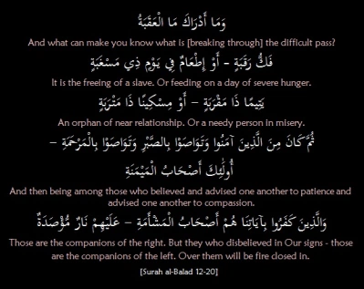
Tafseer of Surah al-Balad: Ayaat 12-20 – The Path to
Moral Heights is Steep like an Uphill Road

Slide 10
Tafseer of Surah al-Balad: Ayaat 12-20 – The Path to
Moral Heights is Steep like an Uphill Road
But he did not brave the ascent/he has not broken through the difficult pass. After reminding man of his reality and Allah’s favors upon him a complaint is being made that all these bounties have not motivated man to attempt the ascent that stands between him and heaven. The word iqtiham means “to apply oneself to a hard and toilsome task,” while ‘aqabah is the steep path that passes through mountains for ascending heights. Thus, the ayah means one of the two paths that We have shown him, leads to heights but is toilsome and steep; man has to tread it against the desires of his self and the temptations of Shaytan. The other path is easy; one only needs to give free reins to oneself, then one automatically goes on rolling down the abyss. Now, the man to whom We had shown both the paths, adopted the easy down-hill path and abandoned the toilsome path, which leads to the heights.
And what will explain to you what the ascent is? In order to attain Paradise, one must take the difficult path of ascent. If he does not, it remains an obstruction to that attainment, for the ascent has been clearly indicated in this verse as the obstacle in the way of reaching the destination.

Slide 11
Tafseer of Surah al-Balad: Ayaat 12-20 – The Path to
Moral Heights is Steep like an Uphill Road
Allah explains to believers how to ascend the difficult pass and how to confront and overcome the obstacles found upon it, enabling them to reach the heights of Paradise: The freeing of a slave. Or the feeding on a day of hunger. An orphan near of kin. Or a destitute in the dust. Then he becomes of those who believe, and advise one another to patience, and advise one another to kindness. It is that they should give up spending for display and pride, and instead spend their wealth to help orphans and the needy. They must be compassionate toward people and participate in the development of a society based on virtue and righteousness. The first thing mentioned is the freeing of a slave or captive. The next verses mention feeding the hungry. A time of famine and hunger (masghabah) when food is scarce becomes a time when faith is tested, for one would not find much difficulty sharing food in times of abundance. The one most deserving of aid and kindness at such a time is an orphan who is also a relative.

Slide 12
Tafseer of Surah al-Balad: Ayaat 12-20 – The Path to
Moral Heights is Steep like an Uphill Road
So the path to Paradise and avoidance of Hellfire is described in these verses as performing certain deeds: in particular, freeing a captive, feeding the hungry among orphans and the destitute, and then true belief and counseling others to have patience and compassion. The conjunction in the Arabic text, thumma, does not indicate a time sequence but is used only as an introduction to the most important aspect of scaling the ascent, which is the belief that gives such deeds their value and weight in the judgment of Allah. These are the people of happiness.
But as for those who defy Our revelations—these are the people of misery. Upon them is a padlocked Fire. Those who rejected Allah's signs and guidance can expect no good. Their denial renders worthless any deeds they might do, no matter how impressive they appear to people on the surface. They will receive their records in their left hands. These are the possessors of ill fortune who will enter the Hellfire, where they will be imprisoned and locked in. They are surrounded by fire and trapped within it; this is their eternal dwelling with no chance of escape. The cover over Hell will be sealed and locked forever, containing its fire and its inhabitants.

Slide 13
Tafseer of Surah ash-Shams
Name- after the word ash-shams (The Sun) with which it opens.
Period of Revelation- The earliest period at Makkah at a stage when opposition to the Prophet (upon whom be Allah's peace) had grown very strong and intense.
Theme and Subject Matter- The Surah which maintains the same rhyme in all its Ayaat encompasses truth about man’s nature, his inherent abilities, choices and responsibilities in determining his own fate. It distinguishes the good from the evil and warns the people, who were refusing to understand this distinction and insisting on following the evil way, of the evil end. Its verses have been seen by several scholars to be an explanation of those in Sūrah al-Layl.

Slide 14
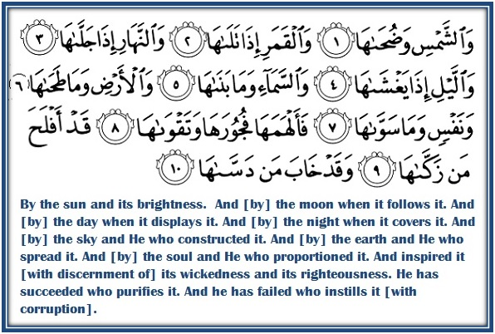
Tafseer of Surah ash-Shams: Ayaat 1-10 – A Look into the Human Soul

Slide 15
Tafseer of Surah ash-Shams: Ayaat 1-10 – A Look into the Human Soul
Allah swears by some of His contrasting creations - “By the sun and its radiance.” First, by the sun and its bright morning light. Dhuḥā specifically expresses the clear light of mid-morning produced by the sun.
Then He swears “And the moon as it follows it” which is visible with the disappearance of the sun, or which follows in its own orbit.
And the day as it reveals it. And the night as it conceals it. Allah swears by the day, making the earth visible, and the night, covering and concealing it in darkness. Or Allah swears by the day in which the sun becomes visible and the night in which it is concealed from view.
And the sky and He who built it. And the earth and He who spread it. The Creator then swears by the sky and by that which structured it, meaning Himself, And He swears by the earth and by that which made its spherical shape seem to man as a flat surface, enabling him to live upon it with ease.

Slide 16
Tafseer of Surah ash-Shams: Ayaat 1-10 – A Look into the Human Soul
And the soul and He who proportioned it. And inspired it with its wickedness and its righteousness. Allah taʽālā then swears by the human soul and by Himself, i.e., the one who created that soul with a sound nature, who balanced and refined it, who instilled in it consciousness and implanted in it a sense of right and wrong. Fujūr denotes rebellion, breach and violation, while taqwā is consciousness of Allah, caution and righteousness.
The object of that oath sworn by Allah is the sūrah's message – man may purify his soul or corrupt it, and he will obtain the result of that. Successful is he who purifies it. Failing is he who corrupts it./Successful is the one who keeps it pure, and ruined is the one who corrupts it.
(Abu Huraira and ibn ‘Abbas radhiAllahu ‘anhum reported that whenever the Prophet salAllahu ‘alayhi wa sallam recited: وَنَفْسٍ وَمَا سَوَّاهَا – فَأَلْهَمَهَا فُجُورَهَا وَتَقْوَاهَا he would stop and say the following du`a,
اللْهُمَّ آتِ نَفْسِي تَقْوَاهَا، أَنْتَ وَلِيُّهَا وَمَوْلَاهَا، وَخَيْرُ مَنْ زَكَّاهَا O Allah! Give my soul its good. You are its Guardian and Master, and the best to purify it.”)

Slide 17
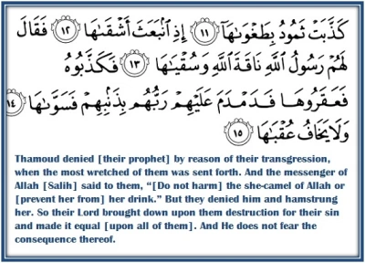
Tafseer of Surah ash-Shams: Ayaat 11-15 – An Example from History

Slide 18
Tafseer of Surah ash-Shams: Ayaat 11-15 – An Example from History
Thamood denied in its pride. When it followed its most wicked. The messenger of Allah said to them, “This is the she-camel of Allah, so let her drink.” But they called him a liar, and hamstrung/crippled her.
After mentioning the two types of people, the successful ones and the unsuccessful ones, Allah gives us an example of the failure which befalls those who corrupt themselves, and erect a barrier between themselves and divine guidance. One example of those who corrupted their souls is the tribe of Thamūd, who denied Allah's prophet, Ṣāliḥ due to their arrogance and tyranny. They had reached a high level of prosperity and power, and Allah had given them authority in the land while prohibiting corruption therein. But they forgot their Lord and turned to sin and idol worship, so a messenger was raised among them to remind and warn them.
The prophet Ṣāliḥ warned the people of Thamūd not to harm the she-camel or deprive her of her right to drink from the water which she shared with them by the command of Allah. But they refused, urging their evil companion to do away with her. The Thamūd defied their prophet and plotted to eliminate the she-camel. Their wicked leader began by slashing her hind legs with his sword, and as she fell the others moved in to kill her. So their Lord crushed them for their sin, and leveled it. And He does not fear its sequel/consequence thereof.

Slide 19
Discussion
Allah reminds man in surah al-Balad of two of His most basic favors. Comment.
Allah explains to believers how to ascend the difficult pass to reach the heights of Paradise. Explain.
Compare between Fujur and Taqwa as mentioned in Surah ash-Shams.
The Surah mentions a bad historical example of mankind. Mention this
example.

