Slide 1
Prophet Adam (AS)
SER 151 – History & Seerah Curriculum – Lecture No. 2
Dr. Nemat Awadalla

Slide 2
Creation of Adam (AS)
Adam is made from the dust of the earth.
God created Adam from a handful of soil containing portions from all its varieties on Earth.
The descendants of Adam were destined to be as diverse as the handful of soil from which their ancestor was created; all have different appearances, attributes, and qualities.

Slide 3
The First Man is Honored
“Prostrate to Adam and they prostrated except Iblees (Satan).” [Taha: 116]
وَإِذْ قُلْنَا لِلْمَلَائِكَةِ اسْجُدُوا لِآدَمَ فَسَجَدُوا إِلَّا إِبْلِيسَ أَبَىٰ وَاسْتَكْبَرَ وَكَانَ مِنَ الْكَافِرِينَ (طه: 116)

Slide 4
The First Man is Honored
God told mankind that He did not create them except that they should worship Him.
Everything in this world was created for Adam and his descendants, in order to aid us in our ability to worship and know God.
Due to God’s infinite Wisdom, Adam and his descendants were to be the caretakers on earth, so God taught Adam what he needed to know to perform this duty.

Slide 5
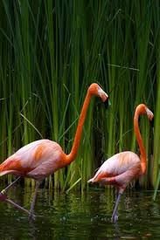


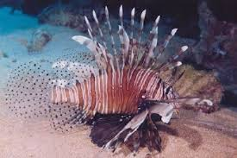


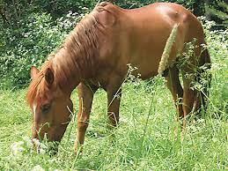

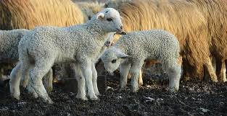
The First Man is Honored
“He taught Adam all the names of everything.” [Baqara: 31]

Slide 6
The First Man is Honored
Adam, was given the ability to reason, make choices and identify objects and their purpose.

Slide 7
Questions
If Iblis was created from fire and thought he was better than Adam who was made of clay, why didn’t the angles see that?

Slide 8
Questions
How dare the angels ask Allah why He will create a human?

