Slide 1
Prophet yusuf(AS)
SER 152 – History & Seerah Curriculum – Lecture No. 7
Dr. Nemat Awadalla

Slide 2
yusuf
Although convinced of Joseph’s innocence, Al Aziz, chief Minister of Egypt put Joseph in prison. He could see no other way of safeguarding the reputation of his name and position

Slide 3
yusuf
He says, one of you will become a close associate of the King, the other will be crucified and birds will eat from his head

Slide 4
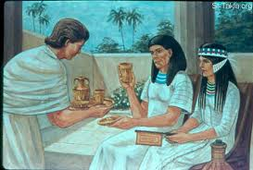
yusuf

Slide 5
yusuf
The King dreamed he was standing on the banks of the Nile watching seven fat cows emerge from the river, followed by seven lean ones. The seven lean cows devoured the fat ones. Next, the dream changed and he watched seven green ears of grain growing on the banks of the Nile. They disappeared into the mud and on the same spot grew seven dry ears of grain.

Slide 6
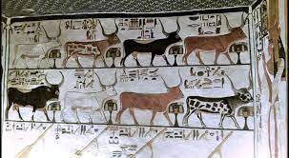
yusuf

Slide 7
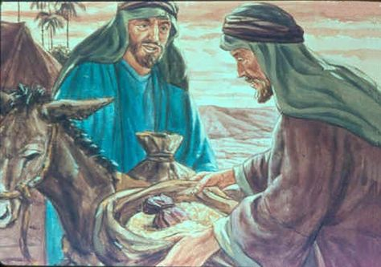
yusuf

Slide 8
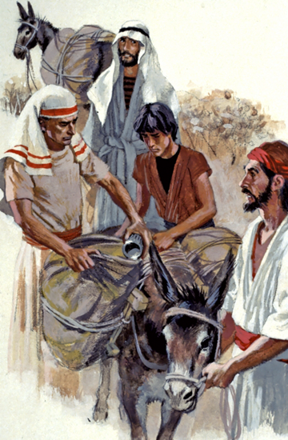
yusuf

