Slide 1
أحكام وآداب ومراتب التلاوة
د. هاله رجب

Slide 2
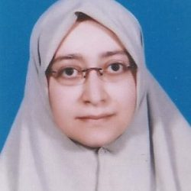
د. هاله رجب
إجازة قراءة وإقراء في قراءات عاصم وقالون وابن كثير وأبو جعفر من طريقي الشاطبية والدرة
4 دبلومات في الدراسات الإسلامية - أكاديمية سماحة
شهادة دار القرآن الكريم (تعادل الثانوية الأزهرية) – الكويت
شهادة معهد الأترجة لعلوم القرآن الكريم - الكويت
دكتوراه المايكروبيولوجي – كلية العلوم – جامعة الأزهر
خبرة في التدريس الأكاديمي والشرعي لأكثر من 18 عاماً
مؤسس ومدير 3 مؤسسات تعليمية إسلامية بكندا (مركز الأترجة للدراسات القرآنية) و (شركة أكاديمية آيات) و (مؤسسة آيات الخيرية)

Slide 3
عناصر المحاضرة
أحكام التلاوة
آداب التلاوة
مراتب التلاوة

Slide 4
أحكام تلاوة القرآن Rules of Quran recitation

Slide 5
بعض الأحكام الفقهية المتعلقة بالقرآن الكريم وقراءته
Some rules of Etiquette for Reciting the Quran
1. It is recommended that the person would make and maintain wudu (ablution) during the recitation of the Quran, wear clean clothes and should recite in a clean place. It is also recommended to clean one’s teeth (using Siwak) as a sign of respect for the Quran. No one should touch the Mushaf (the written Quran) unless the person is in a state of legal purity. There are different opinions regarding whether these rules apply to youngsters or not. However, it is safer to abide by these rules for the youngsters as well.

Slide 6
بعض الأحكام الفقهية المتعلقة بالقرآن الكريم وقراءته
Some rules of Etiquette for Reciting the Quran
2. It is recommended that the person would be sitting facing the Qibla during the recitation. One should be sitting in a state of calm, humbleness, and quietness. However, Recitation of the Quran is allowed while the person is standing up or lying down in bed. However, the reward may be less in these cases.

Slide 7
بعض الأحكام الفقهية المتعلقة بالقرآن الكريم وقراءته
Some rules of Etiquette for Reciting the Quran
3. It is allowable for women during the period or after delivery to recite the Quran without touching the Mushaf or if it is wrapped so that no direct touching occurs. This is mostly the correct opinion of the 2 opinions of the scholars. This is because there is no authentic hadith that states otherwise.

Slide 8
بعض الأحكام الفقهية المتعلقة بالقرآن الكريم وقراءته
Some rules of Etiquette for Reciting the Quran
4. One should memorize surat al-Fatiha applying the correct rules of Tajweed. Surat al-Fatiha is an obligatory component of the prayer, without it the prayer is rendered invalid. This has been stated in the Prophetic hadith, “Whoever does not recite Al-Fatiha in his prayer, his prayer is invalid.“
Narrated by ‘Ubada ibn al-Samit and reported by al-Bukhari

Slide 9
بعض الأحكام الفقهية المتعلقة بالقرآن الكريم وقراءته
Some rules of Etiquette for Reciting the Quran
5. It is legal for the one who is reciting the Quran to make sujud (prostration) whenever he/she comes across a verse in which there is sujud tilawah (recitation prostration). This can be done whether the recitation was during praying or not. A person who is listening to the recitation should follow the reciter in performing or not performing the prostration.

Slide 10
بعض الأحكام الفقهية المتعلقة بالقرآن الكريم وقراءته
Some rules of Etiquette for Reciting the Quran
6. It is considered repugnant to hang portraits or sheets on which the Quranic verses are transcribed.
According to Imam al-Nawawi in his book, “al-Tibyyan fi Adab hamalt al-Quran (The Clear Book of the Rules of Etiquette which should be followed by the People Who Carry the Quran)”

Slide 11
بعض الأحكام الفقهية المتعلقة بالقرآن الكريم وقراءته
Some rules of Etiquette for Reciting the Quran
7. It is recommended for the person who is reciting the Quran, to make a supplication (dou’a) after finishing the recitation. One can ask Allah (SWT) whatever he/she wishes. The Prophet (PBUH) said, “Whoever recited the Quran, should use his recitation to ask Allah (SWT) (of His favor), because there will come a time, where people will use their recitation to ask people (favors).”
Narrated by ‘Imran ibn Husain and reported by Ahmed

Slide 12
بعض الأحكام الفقهية المتعلقة بالقرآن الكريم وقراءته
Some rules of Etiquette for Reciting the Quran
8. When the reciter approaches the end of the Quran, there is no harm in inviting the family to recite the last portion of the Quran together with them. They can make the supplication for completion of the recitation together. Thabet al-Bunani said that, “Anas ibn Malek used to gather his family to recite with them the last portion of the Quran.”

Slide 13
بعض الأحكام الفقهية المتعلقة بالقرآن الكريم وقراءته
Some rules of Etiquette for Reciting the Quran
9. Teaching the Quran and memorizing it is a collective duty for the nation, so that there will be always a group who memorized the Quran to transmit it generation after generation. This is also a way to keep the Quran intact free of any changes or corruption.
The collective duty is a duty that needs to performed, however, it does not have to be performed by every and each one in the community. If the duty has been completed by a group then the whole community is rewarded, but if was not completed then the whole community will bear the sin.
Sheikh ‘Attiyya Qable Nasr, “Ghayat al-Mureed fi ‘ilm al-Tajweed (The Ultimate objective of the student of Tajweed)”

Slide 14
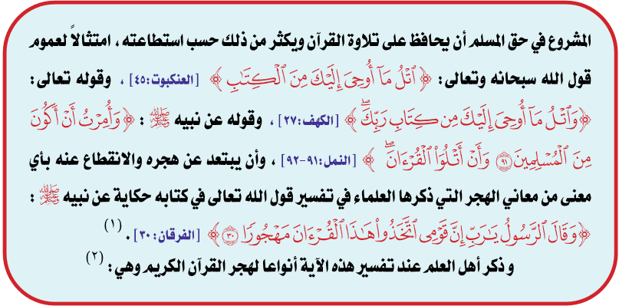
الحذر من هجر القرآن الكريم
Warning against Abandoning the Quran
It has been ordained that Muslims should recite the Quran regularly. They should recite as much as they can, each according to his/her own ability. This has been illustrated by Quranic verses and Prophetic hadith. The Quran says,
“Recite what has been revealed to you of the Book, and establish regular prayer. Prayer prohibits indecencies and evil. And remembrance of God is greater. And God knows what you do.” (al-‘Ankabut: 45)
“And recite that which has been revealed to you of the Book of your Lord. None can change His words, and you will not a refuge other than Him.” (al-Kahf: 27)
“I (Muhammad) am commanded only to serve the Lord of this land which He has hallowed, and to whom belong all things. And I am commanded to be of those who submit (to Him), and to recite the Quran.” (al-Naml: 91-92)
“Then the Messenger will say, ‘My Lord, my people took this Quran as a forsaken thing.’” (al-Furqan: 30)

Slide 15
Forms of forsaking the Quran
أنواع هجر القرآن الكريم
To busy oneself with something and not pay attention to the Quran while it is being recited; or to speak loudly while someone is reciting, so no one can hear the recitation.
To disbelieve in the Quran.
To discontinue reciting the Quran and reflecting on its meaning.
To disregard the injunctions of the Quran in conducting the daily transactions. Thus, one quits complying by its rules.
To disregard its injunctions in deciding what is right and what is wrong.
To abandon it as a tool for healing.
To listen to music and songs instead of listening to the Quran.

Slide 16
آداب تلاوة القرآن
Etiquettes
of Quran recitation

Slide 17
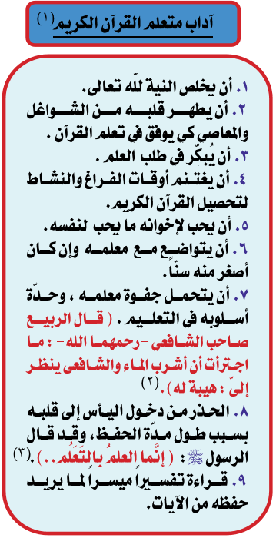
Quran student Etiquette
The learner should have a sincere intention to learn Quran for the sake of Allah (SWT)
The learner should cleanse his/her heart and purify it from distractions and sins.
The learner should start at an early age.
The learner should take the opportunity of any available time to learn the Quran.
The learners should love for their brothers and sisters what they love for themselves.
The learner should show respect to his teacher, even if the teacher was older than him/her.
The learner should respect his/her Quran teacher and his/her prominence. Al-Rabee’, the student of al-Shafi’i (may Allah have mercy on both of them) said, “I did not have the guts to drink water while al-Shafi’i was looking.”
The learner should resist any feeling of despair if it is taking him long to learn. The Prophet (PBUH) said, “Knowledge is earned by learning, …”
The learner should consult an easy to use interpretation of the Quran, to understand the meaning of the verses he/she wants to memorize.

Slide 18
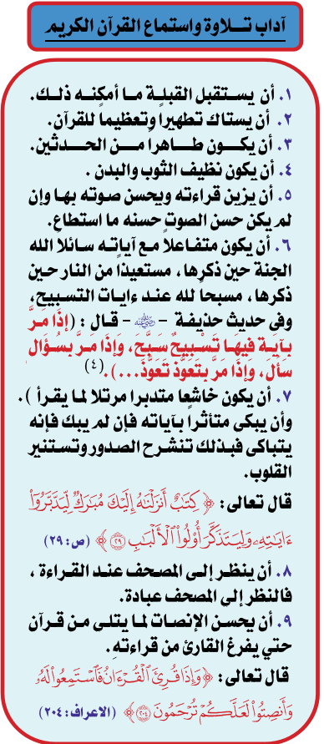
Etiquette of listening and reciting the Quran
One should face toward the Qibla as a much as one can.
One should brush his/her teeth.
One should be in a state of ritual cleanliness and should make and maintain ablution.
One should wear clean clothes and his body should be clean.
One should try to use a nice voice.
One should react emotionally to the verses he/she reading. When he recites verses about paradise, he should ask Allah (SWT) to make paradise his/her abode. When he recites verses about Hellfire, he should ask Allah (SWT) to save him from it. Whenever he recites a verse in which Allah (SWT) is being praised, he should praise Allah (SWT).
One should recite humbly and reflect on the verses being read. He/she may weep and if they cannot, they should simulate weeping. This opens the breast and enlighten the heart of the reciter.
One should look at the verses being read in the Mushaf. Reading from the Mushaf is in itself an act of worship.
One should continue to listen intently to the recitation of the Quran until the recitation is completed, “And when the Qur'an is recited, listen to it and pay heed that you may receive mercy.” (al-A’raf: 204)

Slide 19
مراتب تلاوة القرآن
Levels (Pace and Ranks)
of Quran recitation

Slide 20
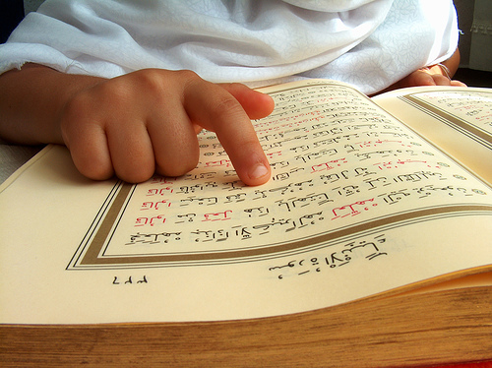
مراتب تلاوة القرآن
Levels (Pace and Ranks) of Quran recitation
للقراءة ثلاث مراتب ... ومرتبة رابعة ذكرها بعض العلماء:
The recitation of the Qur'an has three ranks, but some other scholars state that it has a fourth pace.
التَّرتيل:
أفضل المراتب ... {وَرَتِّلِ الْقُرْآنَ تَرْتِيلاً}
قراءة القرآن الكريم بِتُؤَدَةٍ وطُمأنينة مع تدبر المعاني ومراعاة الأحكام
Tartil:
The best .. "…recite the Qur’an slowly and distinctly." The recitation is at a slow calm pace and the reciter exerts great care in order to pronounce each letter clearly, while strictly following all the rules of Tajwid, and enabling the listeners to ponder on the meaning of the words.

Slide 21
مراتب تلاوة القرآن
Levels (Pace and Ranks) of Quran recitation
للقراءة ثلاث مراتب ... ومرتبة رابعة ذكرها بعض العلماء:
The recitation of the Qur'an has three ranks, but some other scholars state that it has a fourth pace.
التَّدوير:
قراءة القرآن الكريم بحالة متوسطة بين الاطمئنان والسرعة
مع مراعاة الأحكام
Tadwer:
The recitation is at a medium pace between slow & fast recitation with following of the rules of Tajwid.

Slide 22
مراتب تلاوة القرآن
Levels (Pace and Ranks) of Quran recitation
للقراءة ثلاث مراتب ... ومرتبة رابعة ذكرها بعض العلماء:
The recitation of the Qur'an has three ranks, but some other scholars state that it has a fourth pace.
الحـــدر:
قراءة القرآن الكريم بسرعة مع مراعاة الأحكام
ويحترز فيها من الإدماج ونقص المدود والغنات.
Hadr:
Quick recitation, following the rules of Tajwid.
Take care not to mix the letters and to observe the due Mudud (elongation) and the Ghunnah.

Slide 23
مراتب تلاوة القرآن
Levels (Pace and Ranks) of Quran recitation
للقراءة ثلاث مراتب ... ومرتبة رابعة ذكرها بعض العلماء:
The recitation of the Qur'an has three ranks, but some other scholars state that it has a fourth pace.
التحقيق:
قراءة القرآن بطريقة أكثر تؤدة، وأشد اطمئنانًا من مرتبة الترتيل
تستحسن في مقام التعليم
يحترز معها من التمطيط والمبالغة في الغنات والمدود.
Tahkek:
Reciting the Qur'an at a pace slower and calmer than the pace observed in Tartil.
It is preferred when teaching students.
Beware of exaggerating when reciting any elongation.

Slide 24
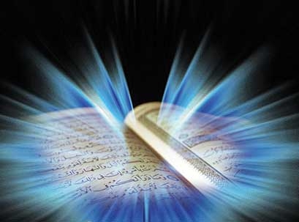
والله من وراء القصد
وهو يهدي السبيل
Jazakom Allah Khairan

