Slide 1
Tafkheem (Fattening) & Tarqeeq (Thinning)
Dr. Ashraf Negm

Slide 2
Agenda
Introduction
Letters of Tafkheem
Letters alternating between Tafkheem & Tarqeeq:
Alef (ا)
Lam (ا) of “الله”
Ra’a (ر)

Slide 3
Introduction المقدمة

Slide 4
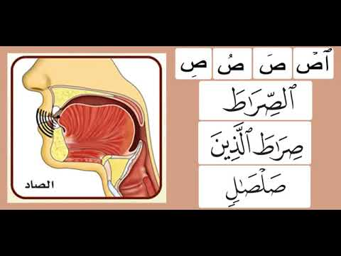
Definition
Tafkheem
Linguistical: Magnification
it means that the letter is pronounced in a magnified way so that its echo fills the mouth cavity

Slide 5
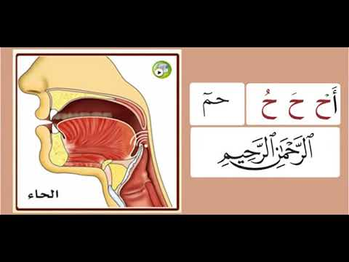
Definition
Tarqeeq
Linguistical:Thinning
it means that the letter is pronounced in a thinned way so that its echo does not fill the out cavity

Slide 6
Classification of letters
Tafkheem
State
ص ض ط ظ – غ خ ق (خص ضغط قظ)
Tarqeeq
State
The rest of the letters
Alternating between Tafkheem and Tarqeeq
ا Alif
ر
ل of الله
Al-Isti’laa
Al-Istifal

Slide 7
Level of Tafkheem (Ibn Al Jazari)
Levels
First | The letter with a fatiha followed by Alif قَال
Second | The letter with a fatiha not followed by Alif خَلقكم
Third | The letter with Dummah يقُول
Fourth | The sakin letter اقْرأ
Fiftn | The letter with a Kasrah قِيل

Slide 8
Al Tafkheem Al Nisbi (Relative)
Definition | To pronounce the letters of Tafkheem having an infitah attribute as if it were Muraqqaqah (Thin)
Letters | ق غ خ
Cases | When the letter has a kasrah, exقِـيل / غِـيض When the letter is sakin and is preceded kasrah, ex تزِغْ - أفرِغْ - إِخْواناً – منِ اغْترف Stopping with sukon on the letter that is preceded by Ya’a, ex شَيْخْ - زَيْغْ

Slide 9
Letters which alternate between Tafkheem & Tarqeeq الحروف الدائرة بين التفخيم والترقيق

Slide 10
Letters which alternate between Tafkheem & Tarqeeq
ر
ل
ا

Slide 11
Letters which alternate between Tafkheem & Tarqeeq
ا
Alif
Rule | Alif follows the letter preceding it
Tafkheem | الصادقين – الضالين – الطامة – الظالمين – خالدين – غافر – قائل - الرَّازقين
Tarqeeq | العابدون – ءامن – باسط – التائبون

Slide 12
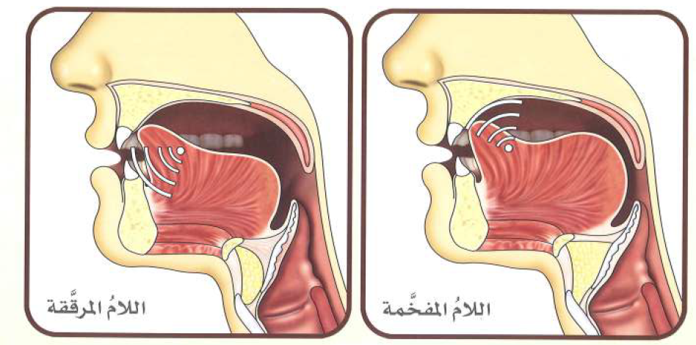
Letters which alternate between Tafkheem & Tarqeeq
ل
Lam of
الله

Slide 13
Letters which alternate between Tafkheem & Tarqeeq
ل
Lam of
الله
 | Rule
Tafkheem | If we start with the word of Majesty اللهُ خالق كل شيئ - اللهِ الذي له ما في السماوات If it is preceded by a letter having a fatiha or dummah (even if the vowel is ‘Ard or the letter in a separate word) عنـدَ الله – عبـدُ الله – تَـالله منَ الله - لهمُ الله
Tarqeeq | If it is preceded by a letter having a kasrah (even if the vowel is ‘Ard or the letter in a separate word) بإذنِ الله - بـهِ الله - بـِالله - قلِ الله - قلِ الله

Slide 14
لَوْ أَنزَلْنَا هَٰذَا الْقُرْآنَ عَلَىٰ جَبَلٍ لَّرَأَيْتَهُ خَاشِعًا مُّتَصَدِّعًا مِّنْ خَشْيَةِ اللَّهِ ۚ وَتِلْكَ الْأَمْثَالُ نَضْرِبُهَا لِلنَّاسِ لَعَلَّهُمْ يَتَفَكَّرُونَ (21) هُوَ اللَّهُ الَّذِي لَا إِلَٰهَ إِلَّا هُوَ ۖ عَالِمُ الْغَيْبِ وَالشَّهَادَةِ ۖ هُوَ الرَّحْمَٰنُ الرَّحِيمُ (22) هُوَ اللَّهُ الَّذِي لَا إِلَٰهَ إِلَّا هُوَ الْمَلِكُ الْقُدُّوسُ السَّلَامُ الْمُؤْمِنُ الْمُهَيْمِنُ الْعَزِيزُ الْجَبَّارُ الْمُتَكَبِّرُ ۚ سُبْحَانَ اللَّهِ عَمَّا يُشْرِكُونَ (23) هُوَ اللَّهُ الْخَالِقُ الْبَارِئُ الْمُصَوِّرُ ۖ لَهُ الْأَسْمَاءُ الْحُسْنَىٰ ۚ يُسَبِّحُ لَهُ مَا فِي السَّمَاوَاتِ وَالْأَرْضِ ۖ وَهُوَ الْعَزِيزُ الْحَكِيمُ (24)
Tafkheem & Tarqeeq
نَضْرِبُهَا
خَـشْيَةِ الله
خَاشِعًا
الْقُـرْآنَ
أَنزَلْـنَا
Practice
تدريب
وَالشَّهَـادَةِ
الْغَـيْبِ
هوَ الله
يَتَـفَكَّرُونَ
الْقُـدُّوسُ
الْمُصَوِّرُ
الْخَـالِقُ
الْجَـبَّـارُ

Slide 15
Letters which alternate between Tafkheem & Tarqeeq
Ra’a that has Haraka (Vowel)
ر
Ra’a
رِ
رُ
رَ
رِيح
رُمَّان
رَعْد

Slide 16
Letters which alternate between Tafkheem & Tarqeeq
Ra’a that has Sukoon
ر
Ra’a
In the beginning of the word
يابنـيَّ ارْكَب
رْ
المطمئنةُ ارْجعي
إنِ ارْتبتم

Slide 17
Letters which alternate between Tafkheem & Tarqeeq
Ra’a that has Sukoon
ر
Ra’a
In the middle or end of the word
Look to the letter before it
القَمَرْ
تَرْميهم
القَدْرْ
َرْ
خُضْرْ
النُذُرْ
تُرْجى
ُر
سِدْرْ
المدثِرْ
فِرْعون
ِرْ

Slide 18
Letters which alternate between Tafkheem & Tarqeeq
Exceptions
ر
Ra’a
1- Preceded by a letter of Isti’la’
القِطْـرِْ
On stopping
Both options &
Tarqeeq is better
مِصْـرَْ
On stopping
Both options &
Tafkheem is better

Slide 19
Letters which alternate between Tafkheem & Tarqeeq
Exceptions
ر
Ra’a
2- followed by a letter of Isti’la’ in the same word
إِرْصَاداً
فِـرْقَة
فِـرْقٍ
قِـرْطَاس
مِـرْصَاداً
لبِالمِـرْصَاد
Tafhkeem only

Slide 20
Letters which alternate between Tafkheem & Tarqeeq
Exceptions
ر
Ra’a
3- Preceded by Ya’a Leen
طَيْـــــرْ
خَيْـــــرْ
On stopping
Tarqeeq only
ضَيْـــــرْ
غَيْـــــرْ

Slide 21
Letters which alternate between Tafkheem & Tarqeeq
Exceptions
ر
Ra’a
4- Followed by a Ya’a that is removed in writing
فَأَسْـرِْي
يَـسْـرِْي
On stopping
Both options &
Tarqeeq is better
أنْ أَسْـرِْي
(6) فكيف كان عذابي ونُذُرِْي

Slide 22
Letters which alternate between Tafkheem & Tarqeeq
Exceptions
ر
Ra’a
5- Followed by Alif with Imalah
مَجْـرَاها
Tarqeeq only

Slide 23
Letters which alternate between Tafkheem & Tarqeeq
Exceptions
ر
Ra’a
مِصْـرَْ
On stopping
Both options &
Tafkheem is better
القِطْـرِْ
On stopping
Both options &
Tarqeeq is better
خَيْـــــرْ
On stopping
Tarqeeq only
مَجْـرَاها
Tarqeeq only
إِرْصَاداً
فِـرْقَة
فِـرْقٍ
قِـرْطَاس
مِـرْصَاداً
لبِالمِـرْصَاد
فَأَسْـرِْي
أنْ أَسْـرِْي
يَـسْـرِْي
On stopping
Both options &
Tarqeeq is better
(6) فكيف كان عذابي ونُذُرِْي
Tafhkeem only

Slide 24
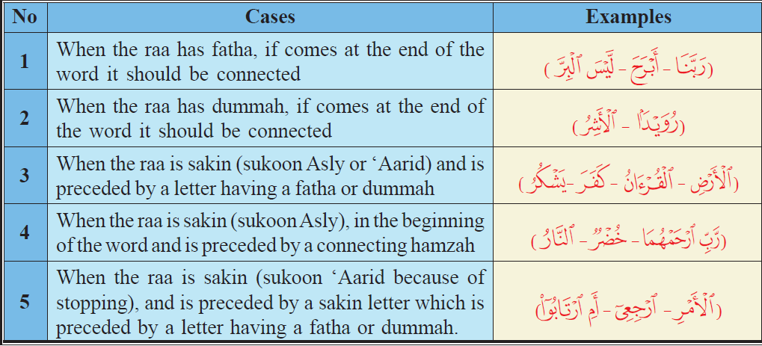
Letters which alternate between Tafkheem & Tarqeeq
Ra’a always with Tafkheem
ر
Ra’a

Slide 25
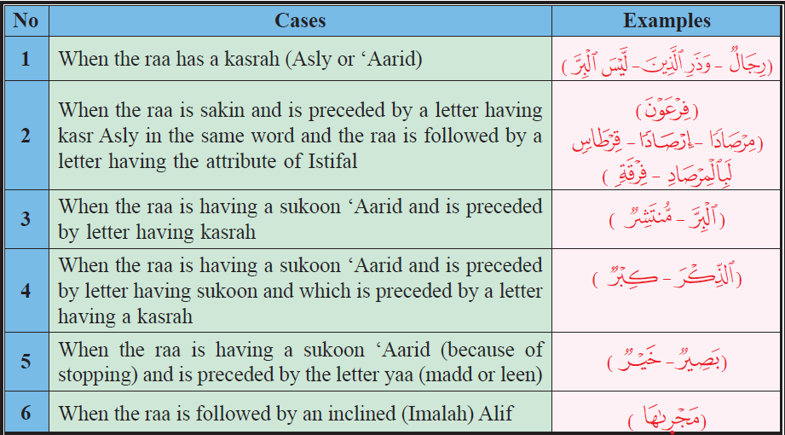
Letters which alternate between Tafkheem & Tarqeeq
ر
Ra’a
Ra’a always with Tarqeeq

Slide 26
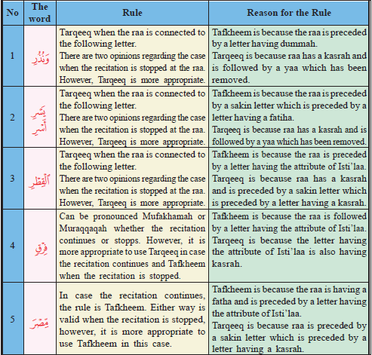
Letters which alternate between Tafkheem & Tarqeeq
ر
Ra’a
Ra’a Alternating between Tafkheem & Tarqeeq

Slide 27
Tafkheem & Tarqeeq
بِسَحَرٍ
كَذَّبَتْ قَوْمُ لُوطٍ بِالنُّذُرِ * إِنَّا أَرْسَلْنَا عَلَيْهِمْ حَاصِبًا إِلاَّ آلَ لُوطٍ نَّجَّيْنَاهُم بِسَحَرٍ * نِعْمَةً مِّنْ عِندِنَا كَذَلِكَ نَجْزِي مَن شَكَرَ * وَلَقَدْ أَنذَرَهُم بَطْشَتَنَا فَتَمَارَوْا بِالنُّذُرِ * وَلَقَدْ رَاوَدُوهُ عَن ضَيْفِهِ فَطَمَسْنَا أَعْيُنَهُمْ فَذُوقُوا عَذَابِي وَنُذُرِ * وَلَقَدْ صَبَّحَهُم بُكْرَةً عَذَابٌ مُّسْتَقِرٌّ * فَذُوقُوا عَذَابِي وَنُذُرِ * وَلَقَدْ يَسَّرْنَا الْقُرْآنَ لِلذِّكْرِ فَهَلْ مِن مُّدَّكِرٍ * وَلَقَدْ جَاءَ آلَ فِرْعَوْنَ النُّذُرُ * كَذَّبُوا بِآيَاتِنَا كُلِّهَا فَأَخَذْنَاهُمْ أَخْذَ عَزِيزٍ مُّقْتَدِرٍ * أَكُفَّارُكُمْ خَيْرٌ مِّنْ أُوْلَئِكُمْ أَمْ لَكُم بَرَاءَةٌ فِي الزُّبُرِ ٌ
أَرْسَلْنَا
بِالنُّذُرِ
بِالنُّذُرِ
فَتَمَارَوْا
أَنذَرَهُم
شَكَرَ
Practice
تدريب
رَاوَدُوهُ
وَنُذُرِ
لِلذِّكْرِ
الْقُرْآنَ
يَسَّرْنَا
وَنُذُرِ
مُّسْتَقِرٌّ
بُكْرَةً
النُّذُرُ
فِرْعَوْنَ
مُّدَّكِرٍ
الزُّبُرِ
بَرَاءَةٌ
أَكُفَّارُكُمْ
مُّقْتَدِرٍ
خَيْرٌ

Slide 28
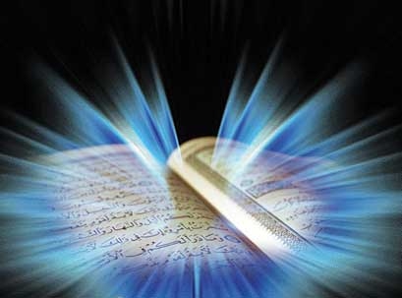
والله من وراء القصد
وهو يهدي السبيل
Jazakom Allah Khairan

