Slide 1
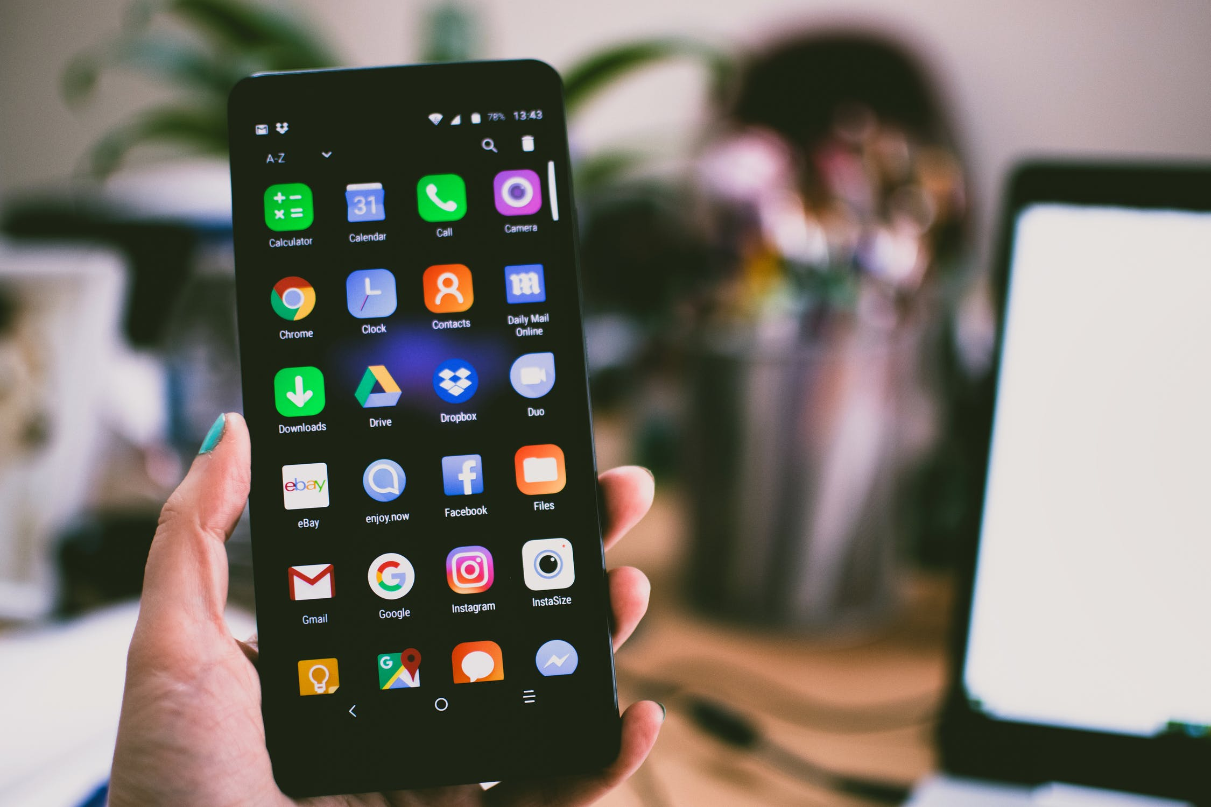
Communication (2) الاتِّصَالَات (2)
Dr. Ehab Atta

Slide 3
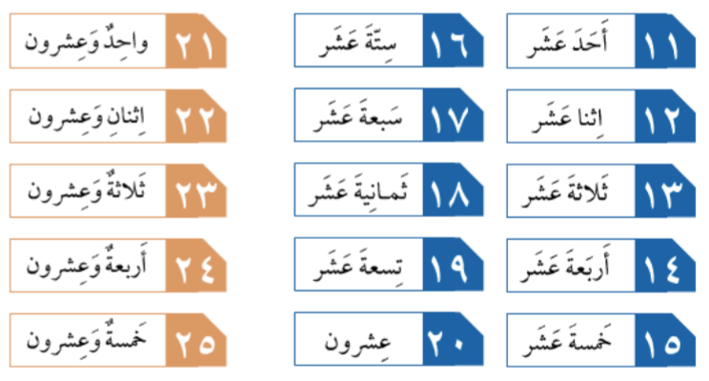

Slide 5
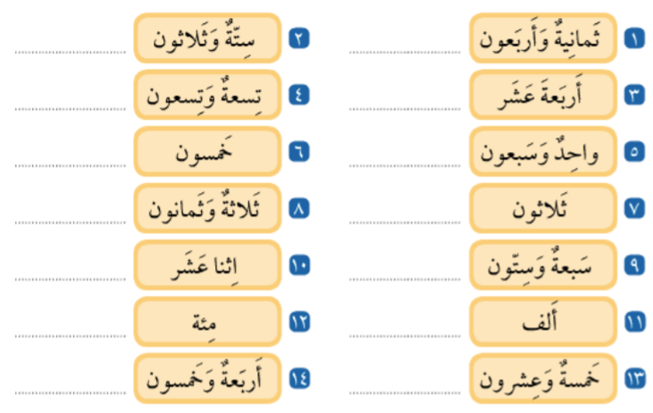

Slide 6
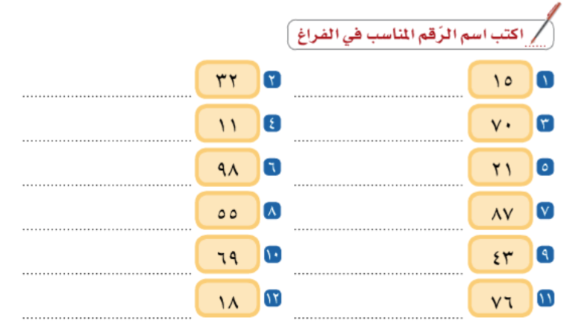

Slide 8
