Slide 1
TAFSEER
QRN 111 – Tafsir Curriculum – Lecture No. 4
Imam Adnan Balihodzic
First Semester
1442H/2020

Slide 2
Agenda
Lecture No. 4
Tafseer of Surah at-Takweer (no. 81th)

Slide 3
Tafseer of Surah at-Takweer
Name- based on the word kuwwirat (The Folding Up) in the first verse. Kuwwirat is passive voice from takweer in the past tense, and means "that which is folded up", thereby implying that it is a Surah in which the "folding up" has been mentioned.
Period of Revelation- The subject matter and the style clearly show that it is one of the earliest Surahs to be revealed at Makkah.
Theme and Subject Matter- This Surah may be divided into two parts, each of them treating one major principle of faith. Accordingly, it has two themes: the resurrection and the revelation (the institution of Prophethood).
ʽAbdullāh bin ʽUmar reported that the Messenger of Allah (PBUH) said, "Whoever would like to see the Day of Resurrection as if with his own eyes may recite Sūrahs atTakweer, al-Infiṭār and al-Inshiqāq". (Recorded by Imam Ahmed and At-Tirmidhi)

Slide 4
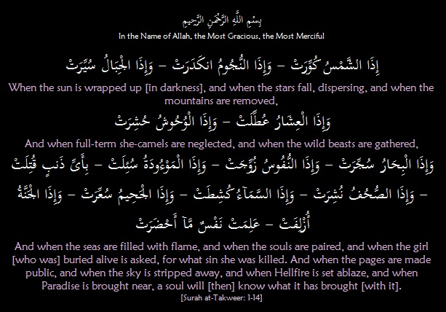
Tafseer of Surah at-Takweer:
Ayaat 1-14 – The Scenes of the Judgment Day

Slide 5
Tafseer of Surah at-Takweer:
Ayaat 1-14 – The Scenes of the Judgment Day
These ayaat sketch a scene of great upheaval which envelopes the whole universe, affecting the heavens, the earth and all their inhabitants, and is a signal of imminent/forthcoming Al-Qiyāmah (the Resurrection). The word idhā (when) has been used twelve times within these first fourteen verses in reference to the happenings of that Day.
The sun will lose its light, the stars will scatter, the mountains will be destroyed, people will become unmindful of their most valuable possessions, the beasts will be gathered together, and the seas will boil. Then souls will be reunited with their bodies, the records will be laid open and the people will be called to account. Every human being will be confronted with whatever good or evil he had done during his worldly existence.
The Surah aims to get this idea of the inevitable upheaval well established in people’s hearts and minds so that they may attach little or no importance to the values and riches of this world. People should establish a firm bond with the everlasting truth, i.e. the truth of Allah, the Eternal, who never changes when everything else changes and disappears.
“When the sun is rolled up/wrapped up,” The word takweer means to fold up; hence takweer al’amamah is used for folding up the turban on the head. Here, the implication is that the light radiating from the sun will be folded up and sun’s radiation will fade. It will be darkened, its light extinguished, it will be folded up, swallowed, sunken in or shriveled. The Prophet saws said, “The sun and the moon will be rolled up on the Day of Judgment.” [Bukhari]

Slide 6
Tafseer of Surah at-Takweer:
Ayaat 1-14 – The Scenes of the Judgment Day
“And when the stars fall, dispersing,” The word inkidar is derived from insibab which means “to be poured out”. Here, the impression has been given that when the force that is keeping the stars in their orbits and positions is loosened and all the stars and planets will scatter in the universe.
“When the mountains are set in motion/removed,” The earth also will lose its force of gravity because of which the firmly rooted mountains will be uprooted from their places and become weightless; moving and flying as the clouds move in the atmosphere.
“And when full-term she-camels are neglected,” This was by far the best way of giving an idea of the severities and horrors of Resurrection to the Arabs. Nothing was more precious to the Arabs than a she-camel just about to give birth. She was about to add to their wealth a highly valued young camel, and to give them a lot of milk. In this state she was most sedulously looked after and cared for, so that she is not lost, stolen, or harmed in any way. However, on that day, which will witness such overwhelming events, such priceless camels will be left without care, completely untended.
“When the beasts are gathered,” The wild beasts will forget their mutual enmities, and come together to move toward an unaware direction. They neither seek their homes nor chase their prey as they usually do. The overwhelming terror changes the character of even the wildest of beasts. What then will it do to the man?

Slide 7
Tafseer of Surah at-Takweer:
Ayaat 1-14 – The Scenes of the Judgment Day
“And when the seas/oceans are filled with flame,” The Arabic term, sujjirat, used in the ayah means “to fill (oven) with fuel, heat, burn, fill (with water), overflow, swell.” One might wonder how the sea will catch fire. When one reflects on the composition of water he learns that it is composed of hydrogen and oxygen. One element helps kindle the fire and the other gets kindled of itself. A simple manifestation of Allah’s power is enough to change this composition of water so that the two gases are separated and begin to burn and help cause a blaze, which is their basic characteristic. If the explosion of a limited number of atoms in a hydrogen or atom bomb produces such dreadful consequences as we have seen, then the atomic explosion of the waters of the oceans, in whatever manner it may occur, will produce something much too fearful for our minds to visualize.
“When the souls are paired,” The pairing of souls may mean the reunion of body and soul at the time of resurrection. It may also mean their grouping, like with like, each soul will be paired with another similar soul, good with good and evil with evil. It can also mean that every soul will be joined with whatever group or sect it used to belong to in the previous life. Ibn Abi Hatim recorded from An-Nu’man bin Bashir that the Messenger of Allah saws said, “Every man will be with every group of people who performed the same deeds that he did. This is because Allah says, ‘And you (all) will be in three groups. So those on the Right Hand – how (fortunate) will be those on Right Hand! And those on the Left Hand – how (unfortunate) will be those on the Left Hand!’ [56: 7-10]. They are those who are alike.”

Slide 8
Tafseer of Surah at-Takweer:
Ayaat 1-14 – The Scenes of the Judgment Day
“When the girl, buried alive, is asked: For what crime/sin she was killed?” Al-Maw’udah is the female infant that the people of the pre-Islamic time of ignorance would dispose of by burying her in the ground. They did this due to fear that a daughter might eventually bring them shame, poverty or humiliation upon having to give her to a man in marriage. A male child was seen to be a future asset to the family and the tribe, whereas the female was a liability.
Obviously this alludes to the fact that they were killed unjustly without having committed any sin or crime. Therefore, on the Day of Judgment, the female infant will be asked what sin she committed that caused her to be murdered, as a means of frightening her murderer. Islam condemns all these barbaric practices of jahiliyyah. It is listed as one of the subjects of reckoning on the Day of Judgment. Here, the Surah mentions it as one of the great events which overwhelms the universe in total upheaval.
“And when the pages/records are made public,” This is a reference to the records of people’s deeds. They are laid open in order that they may be known to everybody. Evil plots and secrets will become known to all. This, in itself, is hard to bear. The hearts conceal secrets, the remembrance of which brings shame to its owner. Yet all secrets are made public on that Day.
“When the sky is peeled/stripped away,” And among the great events which will engulf the universe at the time of the Resurrection is that the familiar protecting and life-sustaining blue cover of atmosphere surrounding the earth will be removed, peeled off; and the heavens will be separated from the earth.

Slide 9
Tafseer of Surah at-Takweer:
Ayaat 1-14 – The Scenes of the Judgment Day
“When the Hellfire is set ablaze. When Paradise is brought near.” The last scene of that fearful day is about heaven and hell. The Qur’ān confirms that Hell has already been created and is waiting to receive the wicked who did not repent from their sins. It “has the fuel of men and stones,” [66: 6]. Paradise has also been created and it is being attended by angels and brought near to those who have been promised admission.
“A soul will [then] know what it has brought [with it],” This is the conclusive response of the previous statements. Allah informs mankind that when all of the aforementioned has taken place, every individual will become fully aware of each deed he did during his lifetime on earth as well as the benefit and harm that resulted from his deeds. No additions or deletions in the records can be made.
In these events of the Day of Judgment, people will find themselves completely separated from all that has been familiar to them, and from their world as a whole. Everything will have undergone a total change except Allah subhanahu wa ta’ala. Therefore, if man turns his attention to Allah in this life, he will find His support in the Hereafter.

Slide 10
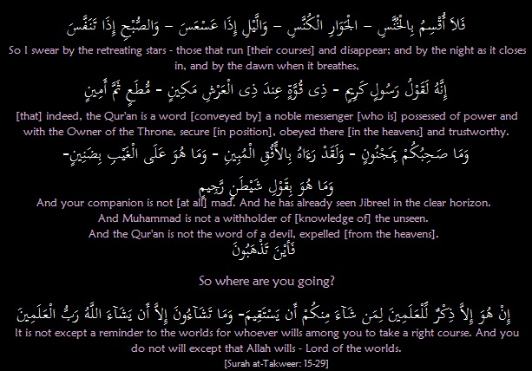
Tafseer of Surah at-Takweer:
Ayaat 15-29 – So where are you going?

Slide 11
Tafseer of Surah at-Takweer:
Ayaat 15-29 – So where are you going?
The second part of the Surah opens with a form of oath using some beautiful scenes of the universe. Essentially, this oath is made to assert the nature of revelation, the angel carrying it, and the Messenger receiving and delivering it to us, as well as people’s attitudes to it, all in accordance with Allah’s will.
“I swear by the retreating stars/Galaxies. Those that run (their courses) and disappear/Precisely running their courses.” The word "lā" preceding the verb has been used to emphasize the oath that Allah swears by several notable phenomena. Al-khunnas are the stars that withdraw or disappear in the light of day. After a brief absence they reappear at another point and become al-jawār al-kunnas, sweeping across the sky in swift movement before setting. Ibn Jareer recorded that ‘Ali being asked about this ayah and he said, “These are the stars that withdraw (disappear) during the day and sweep across the sky (appear) at night.”
The expression, “and by the night as it closes in/recedes,” has two meanings. One of them refers to its advancing with its darkness as Mujahid stated. While Hasan al-Basri said that this means, “When it (night) covers the people.” ʽAsʽasa suggests gently pressing down, the night whose darkness gradually descends and covers everything, but it may also mean the opposite, i.e., gradually lifting or departing. Both interpretations can be found in the Qur’ānic commentaries.
“And by the dawn when it breathes,” means when it rises or when it brightens and advances. Finally, Allah swears by the daybreak when life is renewed. The word tanaffasa describes the early morning as breathing – as though it is alive, spreading its light and causing living things to stir and awaken. It conveys a sense of energy and activity.

Slide 12
Tafseer of Surah at-Takweer:
Ayaat 15-29 – So where are you going?
As the Qur’an makes this brief, full-of-life description it establishes a spiritual link between them and man, with the result that, as we read, we feel the power which created these phenomena, and the truth which we are called upon to believe. It says, “indeed, the Qur’an is a word [conveyed by] a noble messenger.” It then goes on to describe this chosen messenger, “[who is] Endowed with power, eminent with the Lord of the Throne, secure [in position], obeyed there [in the heavens] and trustworthy.” This Messenger is Jibreel Ameen ‘alayhi salaam. What a great honor for Jibreel ‘alayhi salaam to enjoy such a position with the Lord of the universe. He is “obeyed in heaven” by the other angels. He is also “trustworthy” in carrying and discharging such an important message that is the Qur’an.
“This indeed is the Word of (conveyed by) a noble Messenger.” The object of Allah's oath is confirmation that this Qur’ān is a statement from Him which is conveyed by a noble and reliable messenger, the angel Jibreel (Gabriel), who had been granted distinct power and authority by Allah and is obeyed by the other angels and inhabitants of the heavens.
These qualities add up to a definite conclusion: that the Qur’an is a noble, mighty and exalted message and that Allah takes special care of man. It is a manifestation of this care that He has chosen an angel of Jibreel’s caliber to bring His revelations to the man He has chosen as His Messenger saws. As man reflects on this divine care he should feel humble. For he himself is worth very little in the kingdom of Allah, were it not for the care Allah takes of him and the honor He bestows on him.

Slide 13
Tafseer of Surah at-Takweer:
Ayaat 15-29 – So where are you going?
Then follows a description of the Prophet who conveys this revelation to mankind, “And your companion/friend is not [at all] mad/possessed,” The Arabs knew the Prophet saws since his childhood. They knew that he was a man of upright character, and that he had been blessed with extraordinary intellect, wisdom and dignity. But in spite of all this they claimed that he was mad/possessed, and that he received his revelations from the devil. The Surah seems to say: You have known Muhammad (salAllahu ‘alayhi wa sallam) very well over a considerable length of time. He has been known for his honesty and trustworthiness. Why, then are you fabricating tales about him, when he has been telling you the simple truth which he has been entrusted to deliver to you?
“And he has already seen Jibreel in the clear horizon,” meaning that the Prophet is not making it all up. He did not saw Angel Jibreel in a dream rather he saw him with his own eyes, on a clear horizon where no confusion is possible, and received the message directly from him. He had also seen him on the eastern horizon in his true angelic form as Allah created him, with his 600 wings extended and covering the skyline.
“And Muhammad is not a withholder of [knowledge of] the unseen,” meaning that he has not concealed anything. Whatever knowledge of the unseen he had such as the angels, life after death and Resurrection, and the heaven and hell, he has communicated everything without any change. Allah affirms that Prophet Muḥammad (PBUH), who was acknowledged even by his enemies to be honest and trustworthy, had not withheld or neglected to convey anything that was revealed to him of the Qur’ān. He could not logically be accused of doing so. On the contrary, he announced it, conveyed and offered it to everyone who would listen.

Slide 14
Tafseer of Surah at-Takweer:
Ayaat 15-29 – So where are you going?
“And the Qur’an is not the word of a devil, accursed/expelled [from the heavens],” it is because the devils by nature cannot provide such a straightforward and consistent code of conduct.
Hence, the Surah asks disapprovingly, “So where are you going/heading?” How far can you err in your judgment? And where can you go away from the truth?
“It is not except a reminder to the worlds/all mankind for whoever wills among you to take a right course. And you do not will except that Allah wills/But you cannot will, unless Allah wills – Lord of the worlds.” It reminds us that it is up to every individual to choose whether to follow the right path or not. Since Allah has granted everyone his or her free will, then every human being is responsible for himself to follow Allah’s guidance. All doubts have been dispelled, all excuses answered by this clear statement of all the relevant facts. The right path has been indicated for everyone who wishes to be upright. Anyone who follows a different path shall, therefore, bear the responsibility for his actions.
It is, therefore, man’s own will which leads him away from Allah’s guidance. He has no other excuse or justification. The Qur’ān declared the universal nature of this final message; so whoever seeks guidance from his Creator must follow its instruction, for there is no longer valid guidance from Him in any other source. At the end, everything in existence is subject to the will of Allah and no being has a will independent of Allah.

Slide 15
Discussion
The Resurrection day is signaled by a universal upheaval affecting the heavens, the earth and all their inhabitants. Can you describe?
What does the word tanaffasa describe?
The surah describes the angel Jibreel (Gabriel) with many traits. Mention some!
What does the end of this Surah remind us of in regard of following the right path?

