Slide 1
Prophet IBRAHIM (AS)
SER 152 – History & Seerah Curriculum – Lecture No. 2
Dr. Nemat Awadalla

Slide 2
Ibrahim
فَآمَنَ لَهُ لُوطٌ ۘ وَقَالَ إِنِّي مُهَاجِرٌ إِلَىٰ رَبِّي ۖ إِنَّهُ هُوَ الْعَزِيزُ الْحَكِيمُ
But Lut had faith in Him: He said: "I will leave home for the sake of my Lord: for He is Exalted in Might, and Wise."

Slide 3
Ibrahim
رَبَّنَا إِنِّي أَسْكَنْتُ مِنْ ذُرِّيَّتِي بِوَادٍ غَيْرِ ذِي زَرْعٍ عِنْدَ بَيْتِكَ الْمُحَرَّمِ رَبَّنَا لِيُقِيمُوا الصَّلَاةَ فَاجْعَلْ أَفْئِدَةً مِنَ النَّاسِ تَهْوِي إِلَيْهِمْ وَارْزُقْهُمْ مِنَ الثَّمَرَاتِ لَعَلَّهُمْ يَشْكُرُونَ
O our Lord! I have made some of my offspring to dwell in a valley without cultivation, by Thy Sacred House; in order, O our Lord, that they may establish regular Prayer: so fill the hearts of some among men with love towards them, and feed them with fruits: so that they may give thanks.

Slide 4
Ibrahim
رَبَّنَا إِنِّي أَسْكَنْتُ مِنْ ذُرِّيَّتِي بِوَادٍ غَيْرِ ذِي زَرْعٍ عِنْدَ بَيْتِكَ الْمُحَرَّمِ رَبَّنَا لِيُقِيمُوا الصَّلَاةَ فَاجْعَلْ أَفْئِدَةً مِنَ النَّاسِ تَهْوِي إِلَيْهِمْ وَارْزُقْهُمْ مِنَ الثَّمَرَاتِ لَعَلَّهُمْ يَشْكُرُونَ
"O our Lord! I have made some of my offspring to dwell in a valley without cultivation, by Thy Sacred House; in order, O our Lord, that they may establish regular Prayer: so fill the hearts of some among men with love towards them, and feed them with fruits: so that they may give thanks. ( ibrahim 37)

Slide 5
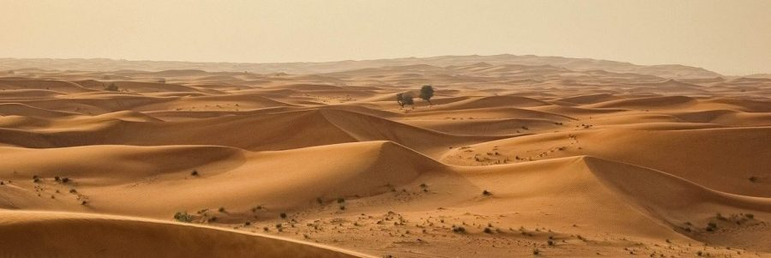
Ibrahim

Slide 6
Ibrahim
ان الصفا والمروة من شعائر الله فمن حج البيت او اعتمر فلا جناح عليه ان يطوف بهما وكم تطوع خيرا فإن الله شاكر عليم ( البقرة -158)
“Behold! Safa and Marwa are among the Symbols of Allah. So if those who visit the House in the Season or at other times, should compass them round, it is no sin in them. And if any one obeyeth his own impulse to Good, be sure that Allah is He Who recogniseth and knoweth.”

Slide 7
Ibrahim
فَلَمَّا بَلَغَ مَعَهُ السَّعْيَ قَالَ يَا بُنَيَّ إِنِّي أَرَىٰ فِي الْمَنَامِ أَنِّي أَذْبَحُكَ فَانْظُرْ مَاذَا تَرَىٰ ۚ قَالَ يَا أَبَتِ افْعَلْ مَا تُؤْمَرُ ۖ سَتَجِدُنِي إِنْ شَاءَ اللَّهُ مِنَ الصَّابِرِينَ ( الصافات -102)
Then, when (the son) reached (the age of) (serious) work with him, he said: "O my son! I see in vision that I offer thee in sacrifice: Now see what is thy view!" (The son) said: "O my father! Do as thou art commanded: thou will find me, if Allah so wills one practising Patience and Constancy!"

Slide 8
Ibrahim
فَلَمَّا أَسْلَمَا وَتَلَّهُ لِلْجَبِينِ # وَنَادَيْنَاهُ أَنْ يَا إِبْرَاهِيمُ # قَدْ صَدَّقْتَ الرُّؤْيَا ۚ إِنَّا كَذَٰلِكَ نَجْزِي الْمُحْسِنِينَ # إِنَّ هَٰذَا لَهُوَ الْبَلَاءُ الْمُبِينُ# وَفَدَيْنَاهُ بِذِبْحٍ عَظِيمٍ # ( الصافات 103-107)
So when they had both submitted their wills (to Allah., and he had laid him prostrate on his forehead (for sacrifice),# We called out to him "O Abraham! "#Thou hast already fulfilled the vision!" -# thus indeed do We reward those who do right.# For this was obviously a trial-# And We ransomed him with a momentous sacrifice:

Slide 9
Ibrahim
وَإِذْ يَرْفَعُ إِبْرَاهِيمُ الْقَوَاعِدَ مِنَ الْبَيْتِ وَإِسْمَاعِيلُ رَبَّنَا تَقَبَّلْ مِنَّا ۖ إِنَّكَ أَنْتَ السَّمِيعُ الْعَلِيمُ # رَبَّنَا وَاجْعَلْنَا مُسْلِمَيْنِ لَكَ وَمِنْ ذُرِّيَّتِنَا أُمَّةً مُسْلِمَةً لَكَ وَأَرِنَا مَنَاسِكَنَا وَتُبْ عَلَيْنَا ۖ إِنَّكَ أَنْتَ التَّوَّابُ الرَّحِيمُ # رَبَّنَا وَابْعَثْ فِيهِمْ رَسُولًا مِنْهُمْ يَتْلُو عَلَيْهِمْ آيَاتِكَ وَيُعَلِّمُهُمُ الْكِتَابَ وَالْحِكْمَةَ وَيُزَكِّيهِمْ ۚ إِنَّكَ أَنْتَ الْعَزِيزُ الْحَكِيمُ (البقرة 127-129)
And remember Abraham and Isma'il raised the foundations of the House (With this prayer): "Our Lord! Accept (this service) from us: For Thou art the All-Hearing, the All-knowing.#"Our Lord! make of us Muslims, bowing to Thy (Will), and of our progeny a people Muslim, bowing to Thy (will); and show us our place for the celebration of (due) rites; and turn unto us (in Mercy); for Thou art the Oft-Returning, Most Merciful.# "Our Lord! send amongst them an Messenger of their own, who shall rehearse Thy Signs to them and instruct them in scripture and wisdom, and sanctify them: For Thou art the Exalted in Might, the Wise.

Slide 10
Ibrahim
وَأَذِّنْ فِي النَّاسِ بِالْحَجِّ يَأْتُوكَ رِجَالًا وَعَلَىٰ كُلِّ ضَامِرٍ يَأْتِينَ مِنْ كُلِّ فَجٍّ عَمِيقٍ
"And proclaim the Pilgrimage among men: they will come to thee on foot and (mounted) on every kind of camel, lean on account of journeys through deep and distant mountain highways;

