Slide 1
ISAAC AND jACOB
SER 152 – History & Seerah Curriculum – Lecture No. 5
Dr. Nemat Awadalla

Slide 2
ISAAC AND jACOB
وَبَشَّرْنَاهُ بِإِسْحَاقَ نَبِيًّا مِّنَ الصَّالِحِينَ ( الصافات 112 )
And We gave him good tidings of Isaac, a prophet from among the righteous.

Slide 3
ISAAC AND jACOB
يقول الله -سبحانه وتعالى- عن إبراهيم -عليه السلام-:
(إِذْ قَالَ لَهُ رَبُّهُ أَسْلِمْ قَالَ أَسْلَمْتُ لِرَبِّ الْعَالَمِينَ)البقرة 131
When his Lord said to him, "Submit," he said, "I have submitted to the Lord of the worlds.

Slide 4
ISAAC AND jACOB
امْرَأَتُهُ قَائِمَةٌ فَضَحِكَتْ فَبَشَّرْنَاهَا بِإِسْحَاقَ وَمِن وَرَاءِ إِسْحَاقَ يَعْقُوبَ (71هود)
And his wife was standing, and she smiled. Then We gave her good tidings of Isaac and after Isaac, Jacob.

Slide 5
ISAAC AND jACOB
Or were you witnesses when death approached Jacob, when he said to his sons, "What will you worship after me?" They said, "We will worship your God and the God of your fathers, Abraham and Ishmael and Isaac - one God.[46] And we are Muslims [in submission] to Him.
أَمْ كُنتُمْ شُهَدَاءَ إِذْ حَضَرَ يَعْقُوبَ الْمَوْتُ إِذْ قَالَ لِبَنِيهِ مَا تَعْبُدُونَ مِن بَعْدِي قَالُوا نَعْبُدُ إِلَٰهَكَ وَإِلَٰهَ آبَائِكَ إِبْرَاهِيمَ وَإِسْمَاعِيلَ وَإِسْحَاقَ إِلَٰهًا وَاحِدًا وَنَحْنُ لَهُ مُسْلِمُونَ

Slide 6
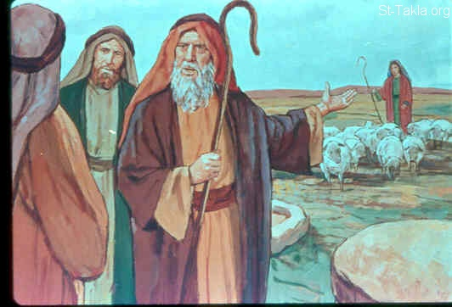
ISAAC AND jACOB

Slide 7
ISAAC AND jACOB

Slide 8
ISAAC AND jACOB
O father we went racing we left yusuf with our things.. So a wolf ate him

Slide 9
ISAAC AND jACOB

Slide 10
ISAAC AND jACOB
What are the lessons we can have from prophet Nuh’s story?

