Slide 1
التَّسَوُّق (2)
Shopping (2)
Dr. Ehab Atta

Slide 2
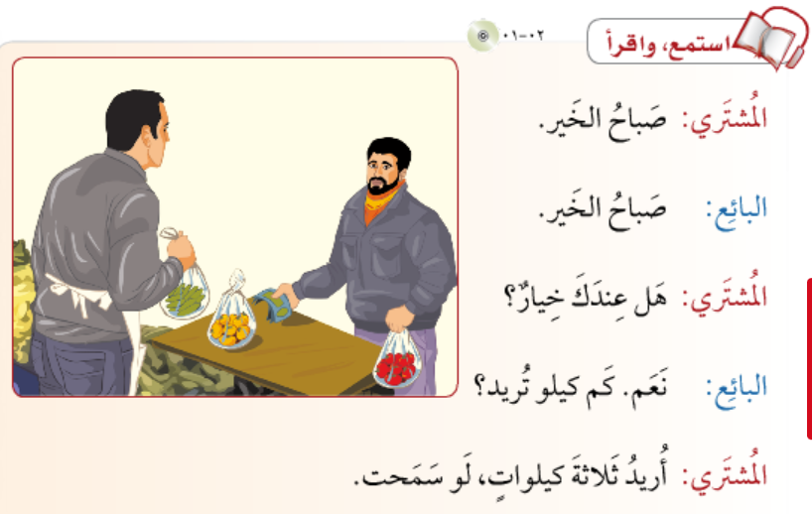

Slide 3
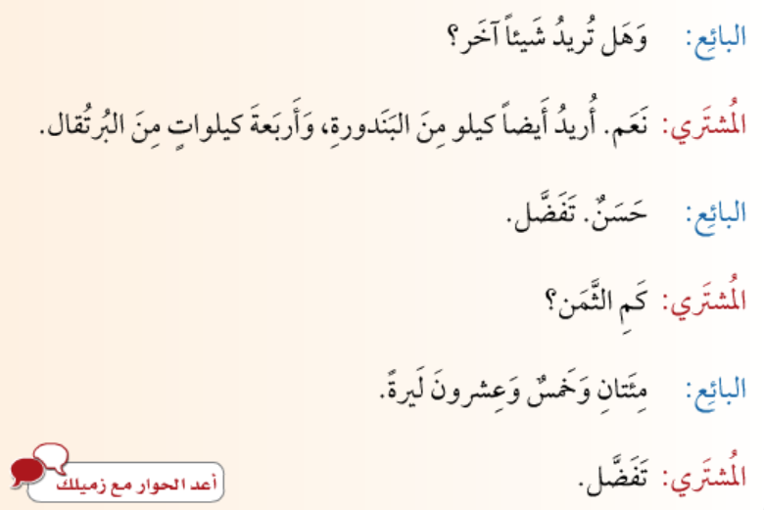

Slide 4
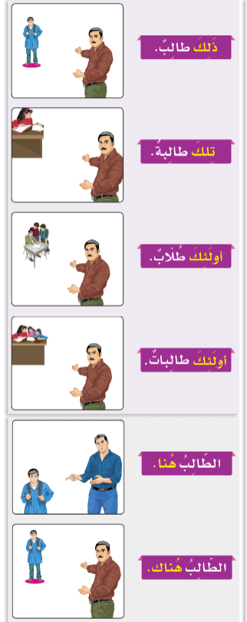
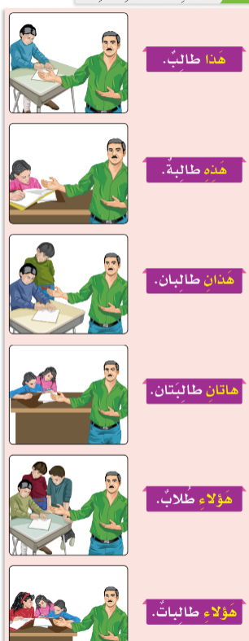

Slide 5
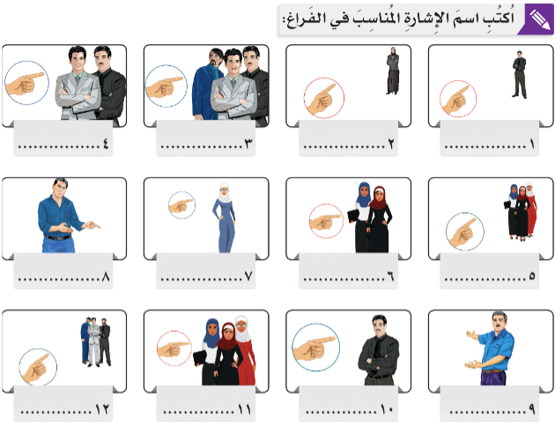

Slide 6
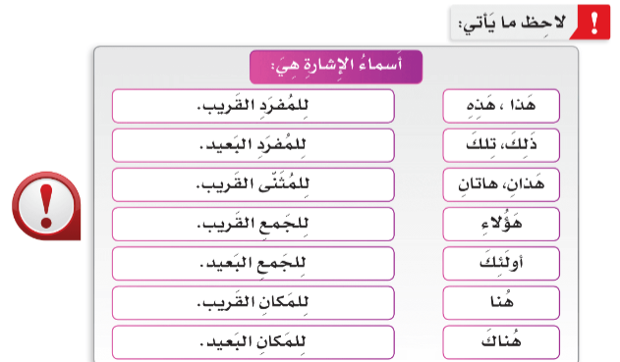

Slide 7
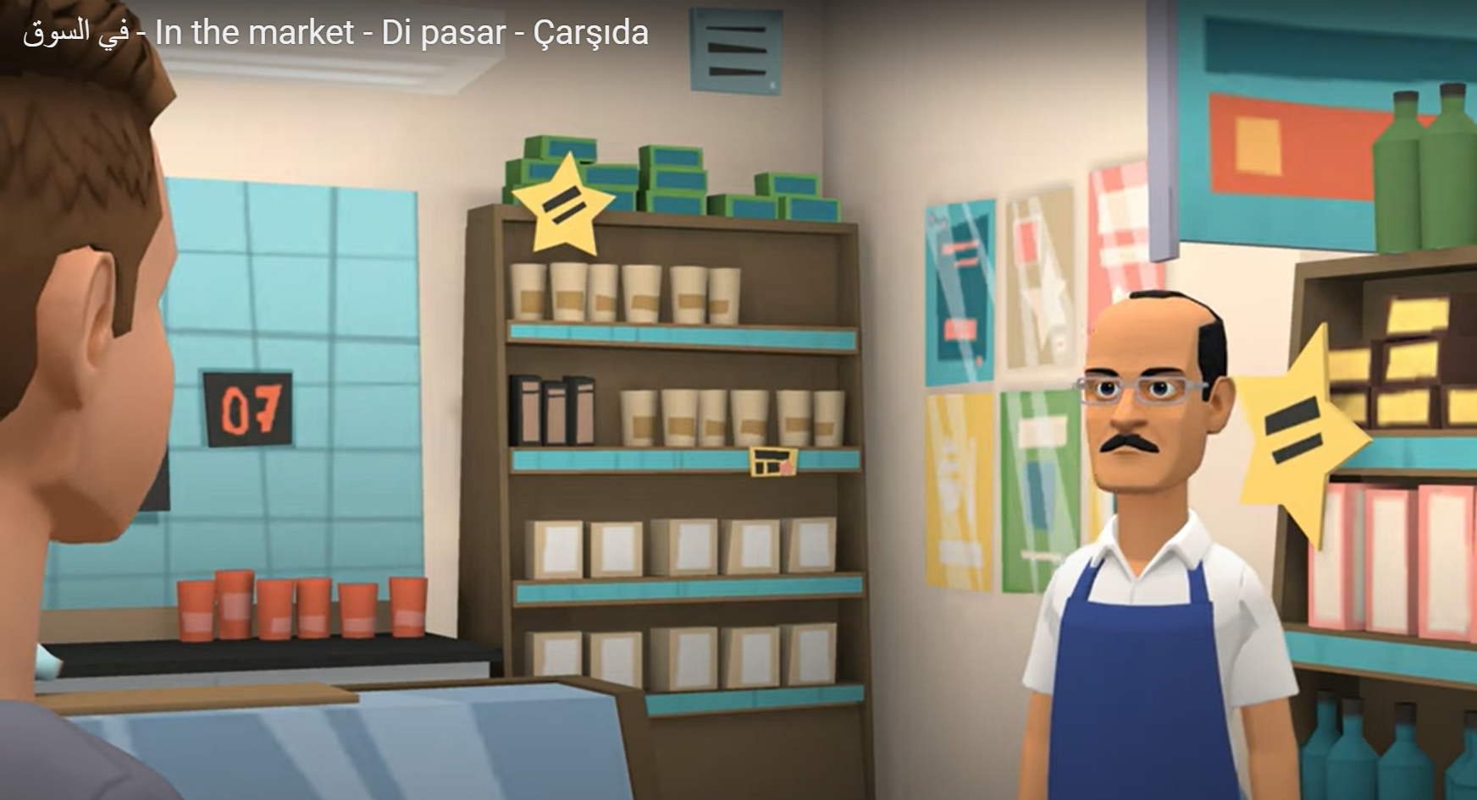
https://youtu.be/DTYqAYNc8cA?si=cVH1XoHs9k_l7xyl

Slide 8


