Slide 1
Biographies of Qura’a
& Scholars of Tajweed
Dr. Ashraf Negm

Slide 2
Agenda
Biography & Sanad of Imam Asem
Biography of Imam Hafs
Biography of Imam Al-Shatibi
Biography & Sanad of Imam Ibn Al-Jazri

Slide 3
Imam Asem

Slide 4
Imam Hafs
180 A.H.

Slide 5
Imam
Al-Shatibi

Slide 6
Imam Ibn
Al-Jazri

Slide 7
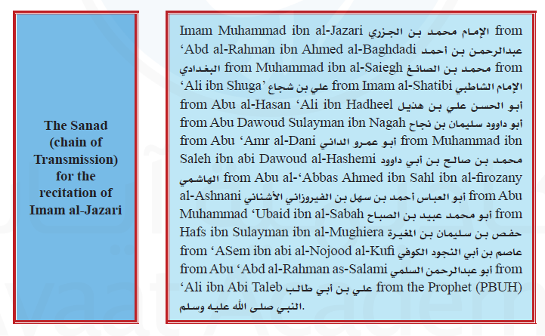
Imam Ibn
Al-Jazri

Slide 8
والله من وراء القصد
وهو يهدي السبيل
Jazakom Allah Khairan

