Slide 1
التَّسَوُّق (2) Shopping (2)
Dr. Ehab Atta

Slide 2
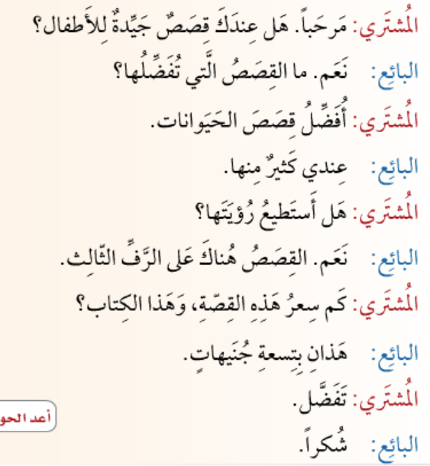

Slide 5
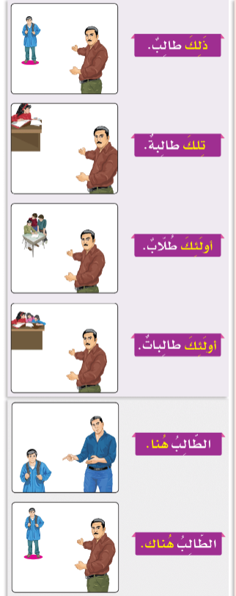
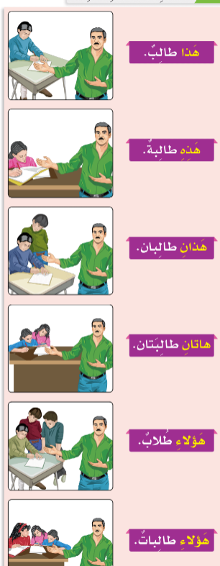

Slide 6
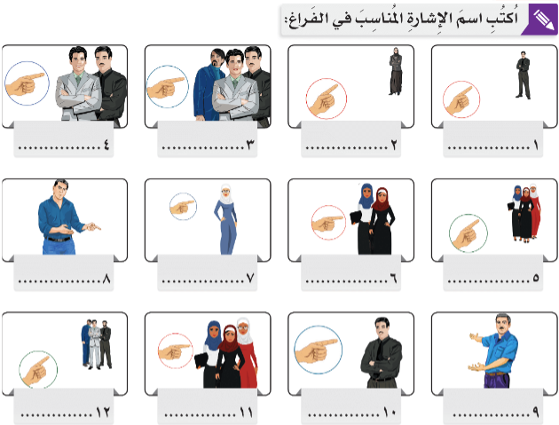

Slide 7
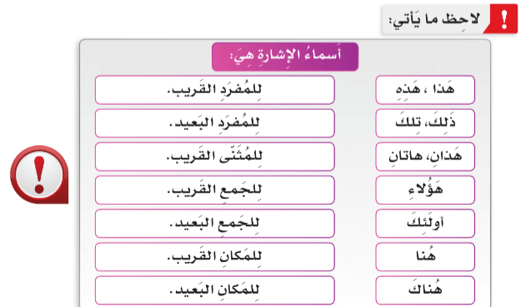

Slide 8
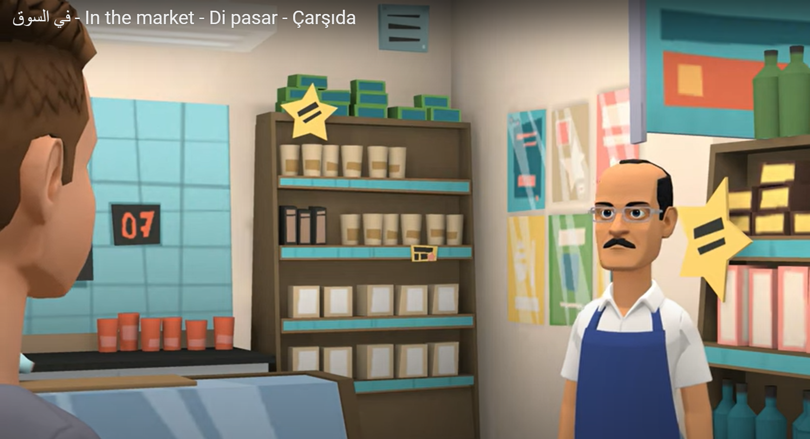
https://youtu.be/DTYqAYNc8cA?si=cVH1XoHs9k_l7xyl

